Slide 1

Welcome

Slide 2
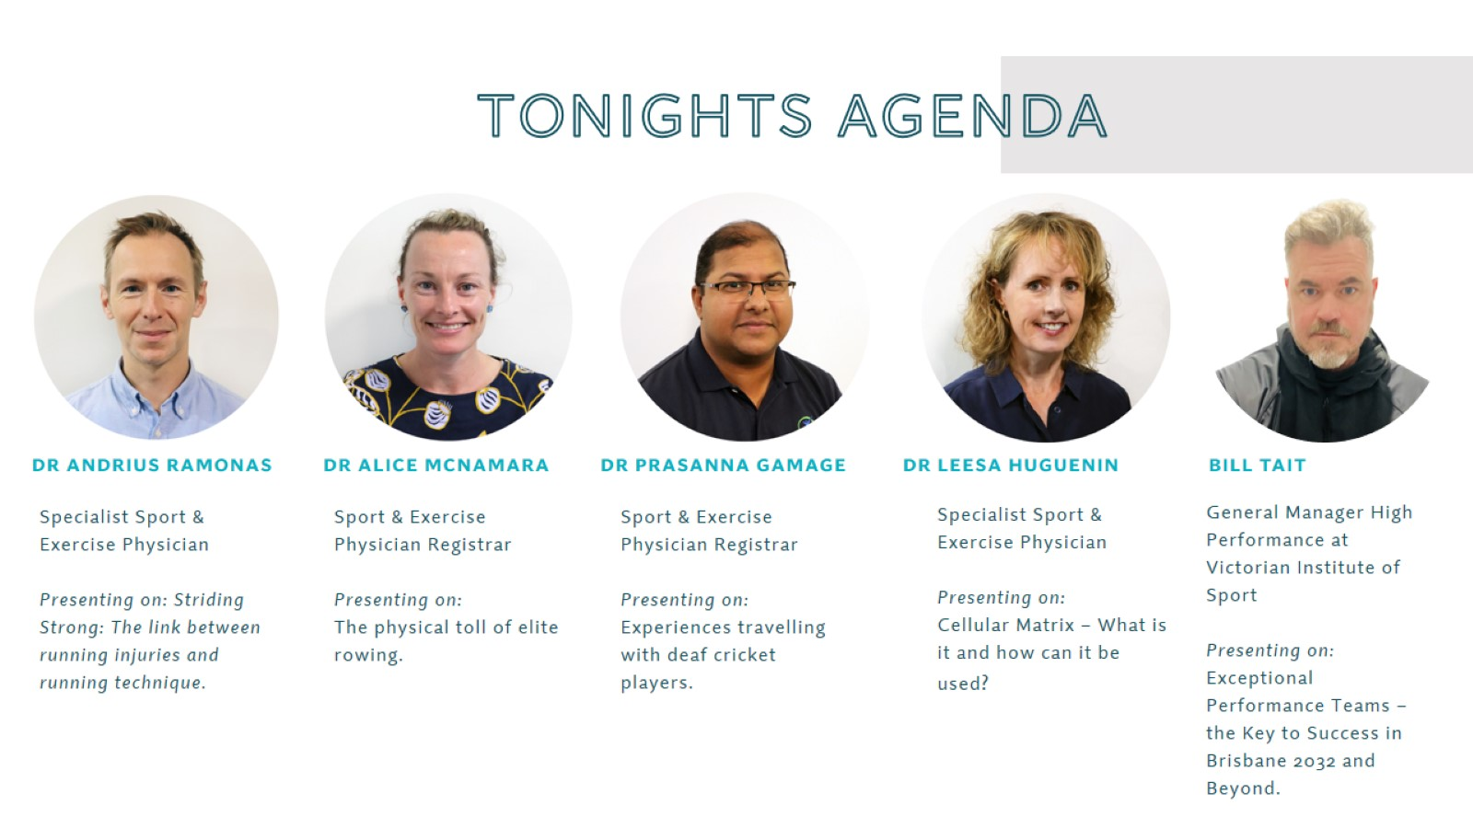
TONIGHTS AGENDA

Slide 3
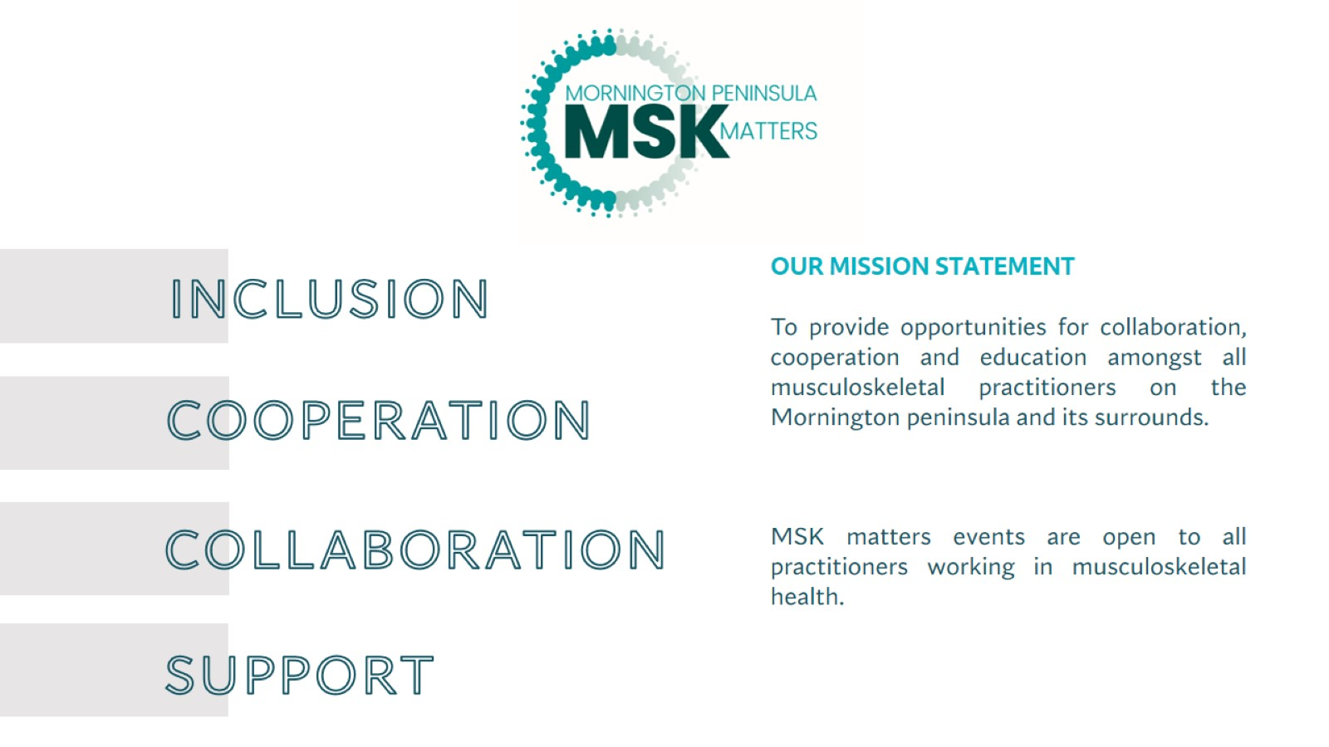
inclusion

Slide 4
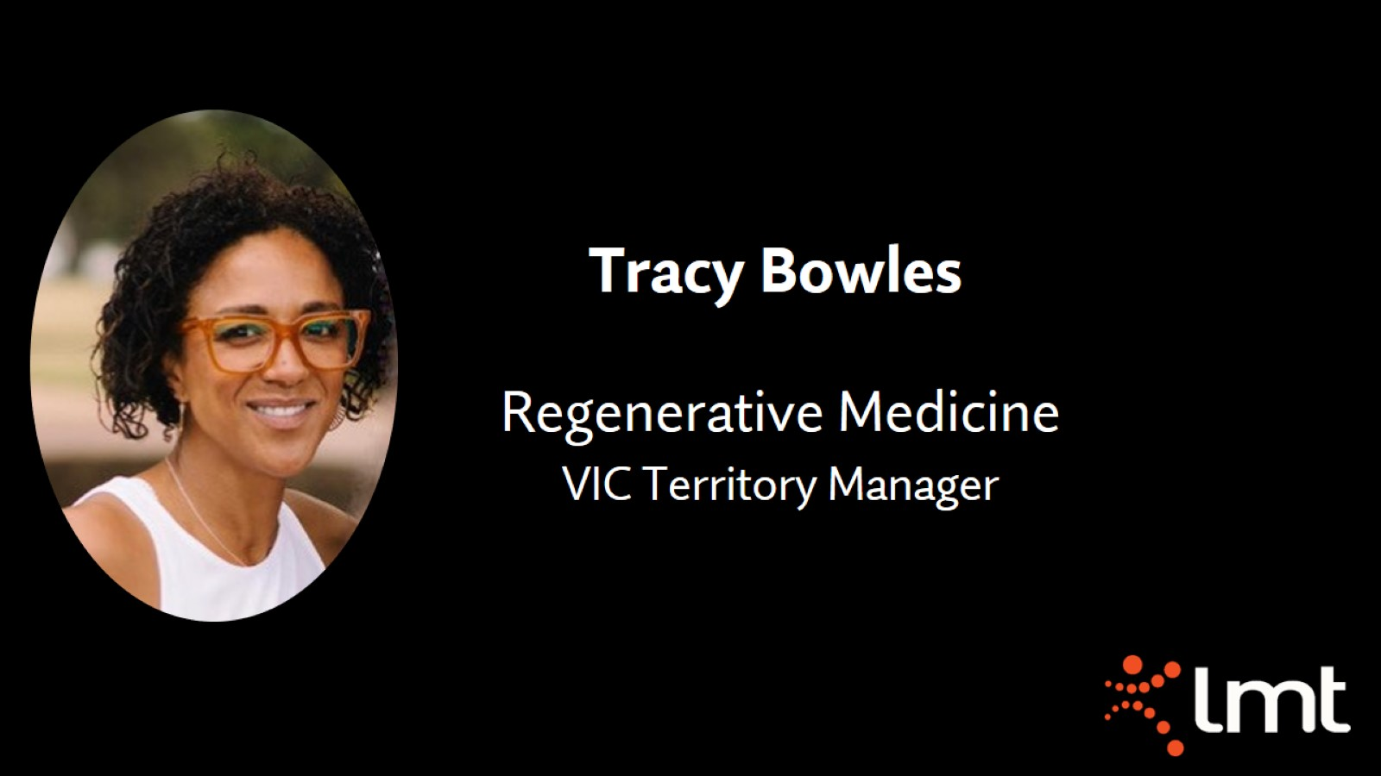

Slide 5


Slide 6
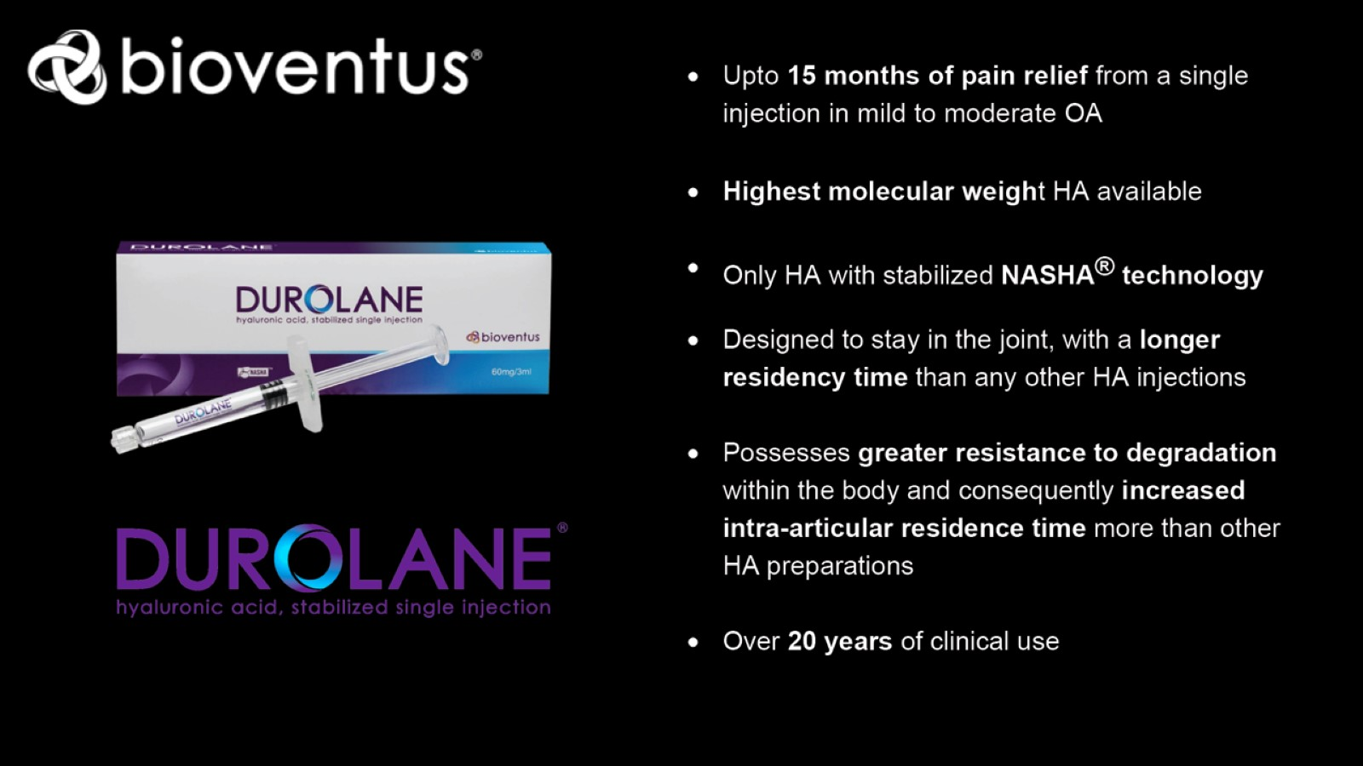

Slide 7
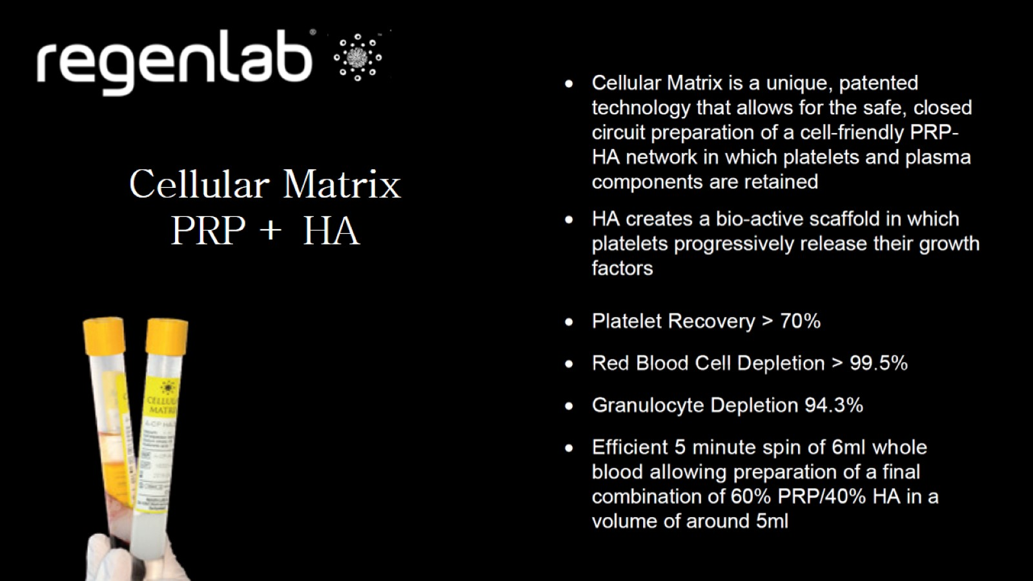

Slide 8
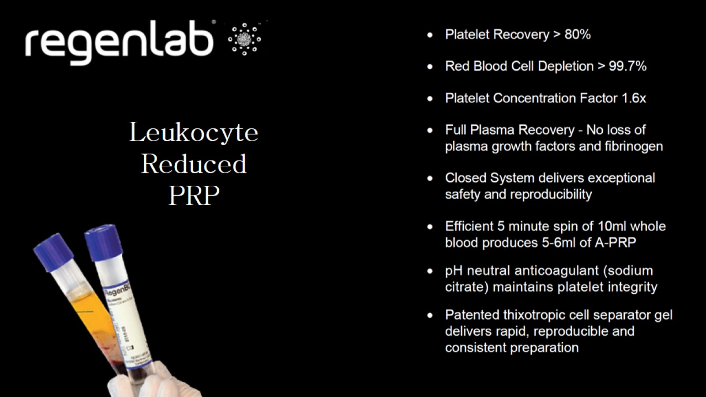

Slide 9
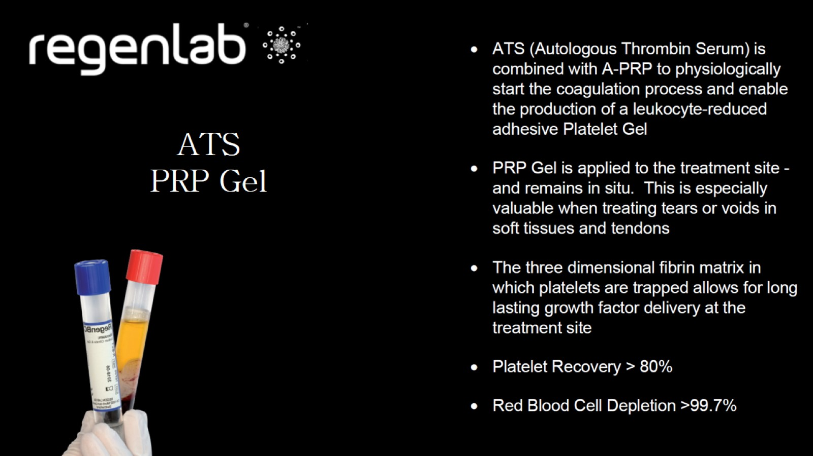

Slide 10


Slide 11
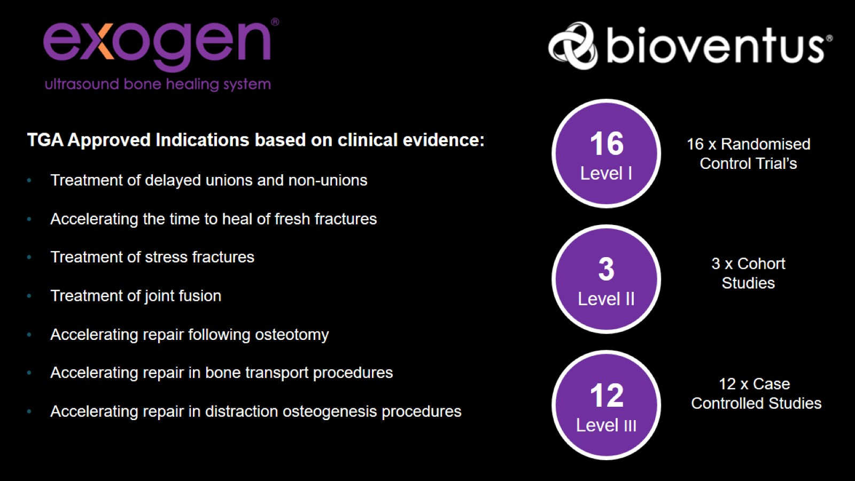

Slide 12
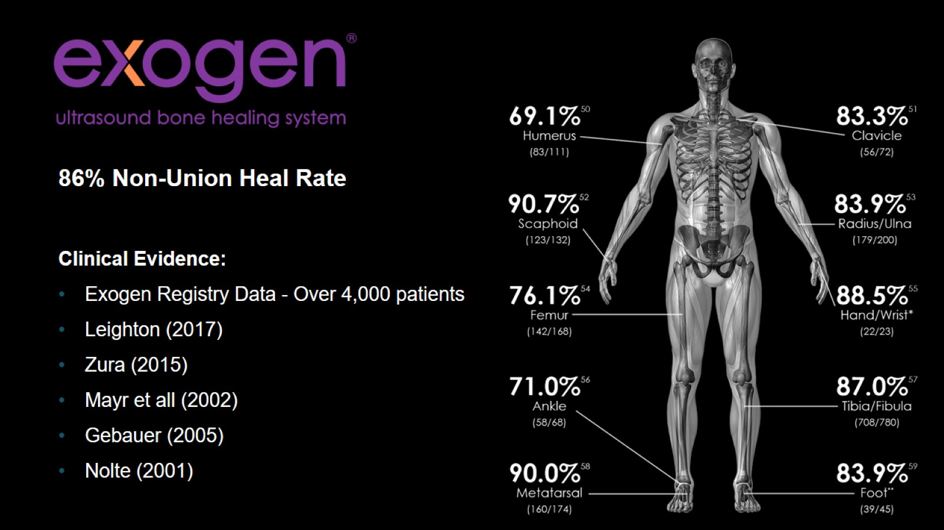

Slide 13
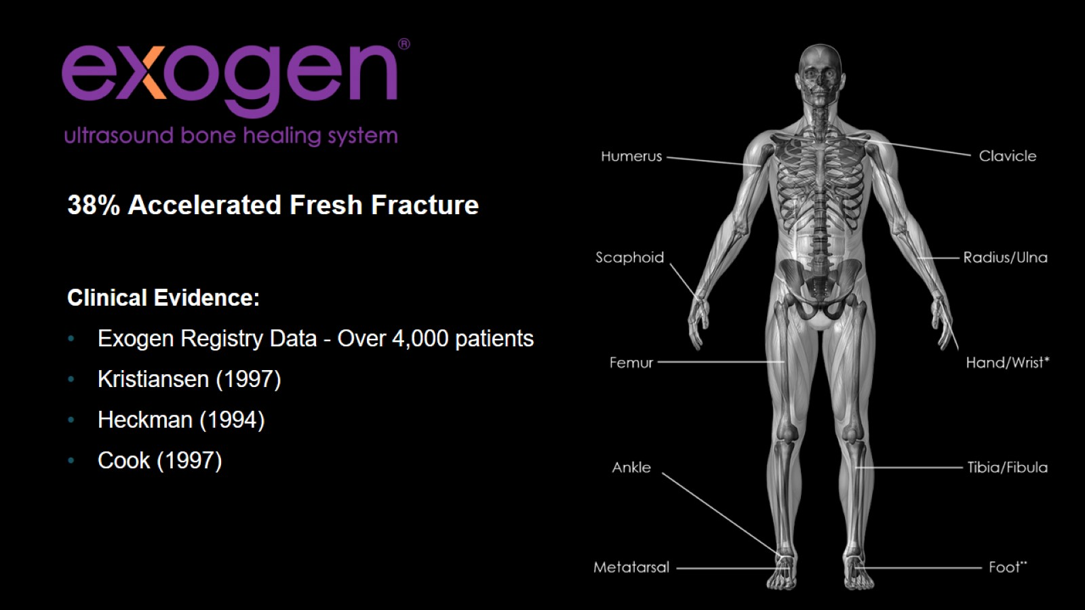

Slide 14

Thank you….

Slide 15
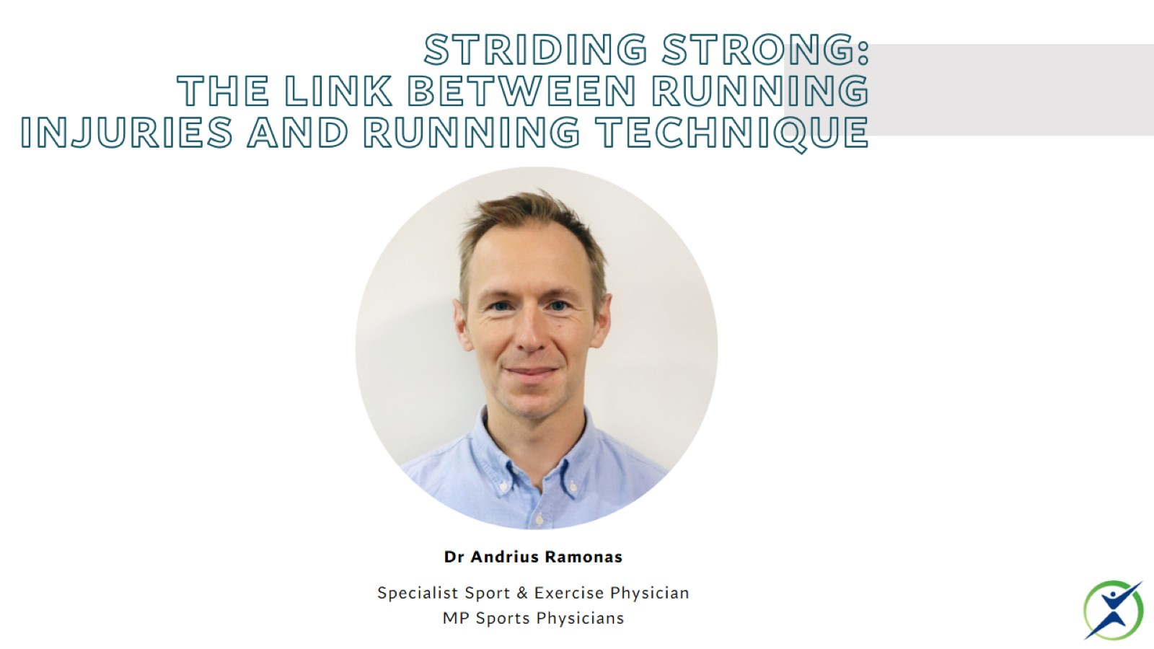
Striding Strong:
The Link between Running Injuries and Running Technique

Slide 16
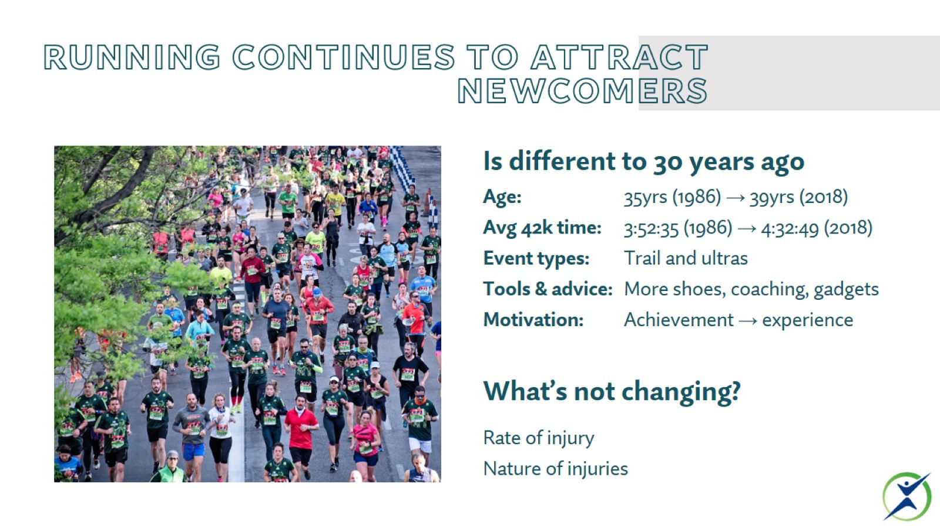
Running continues to attract newcomers

Slide 17
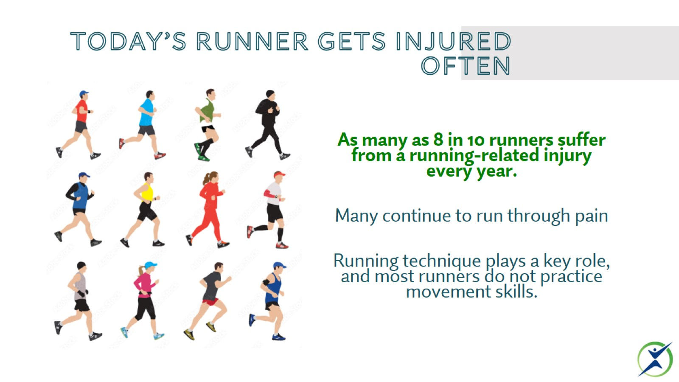
Today’s runner gets injured often

Slide 18
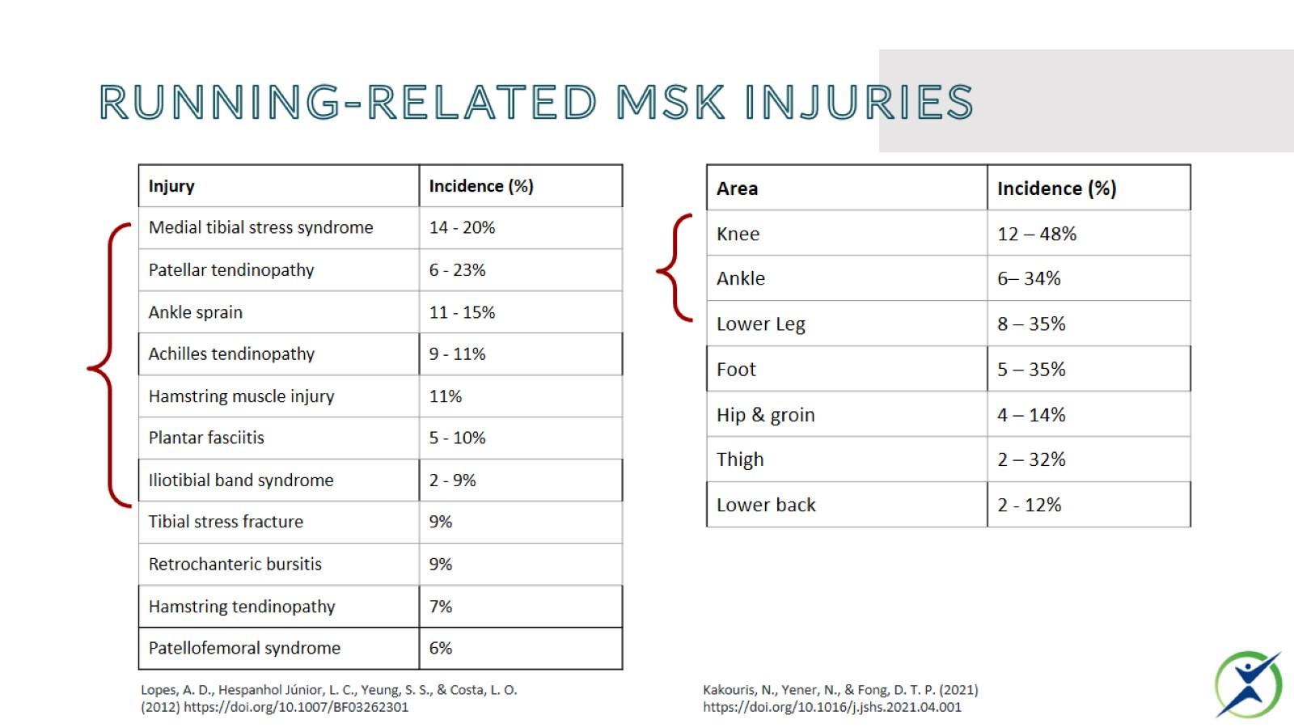
Running-related msk injuries

Slide 19
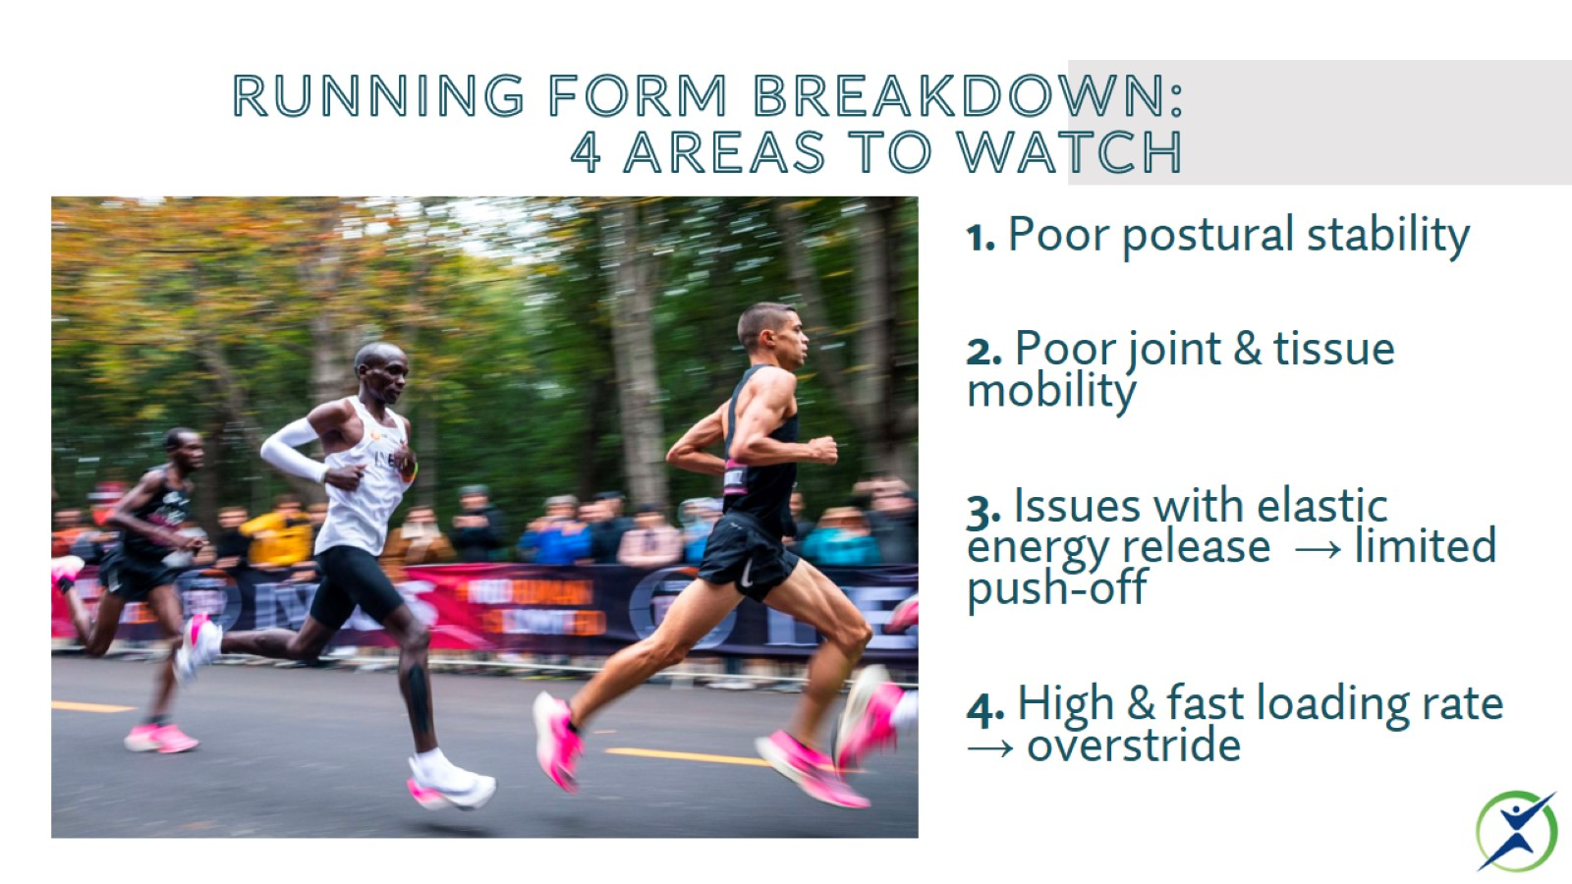
Running form breakdown:
4 areas to watch

Slide 20
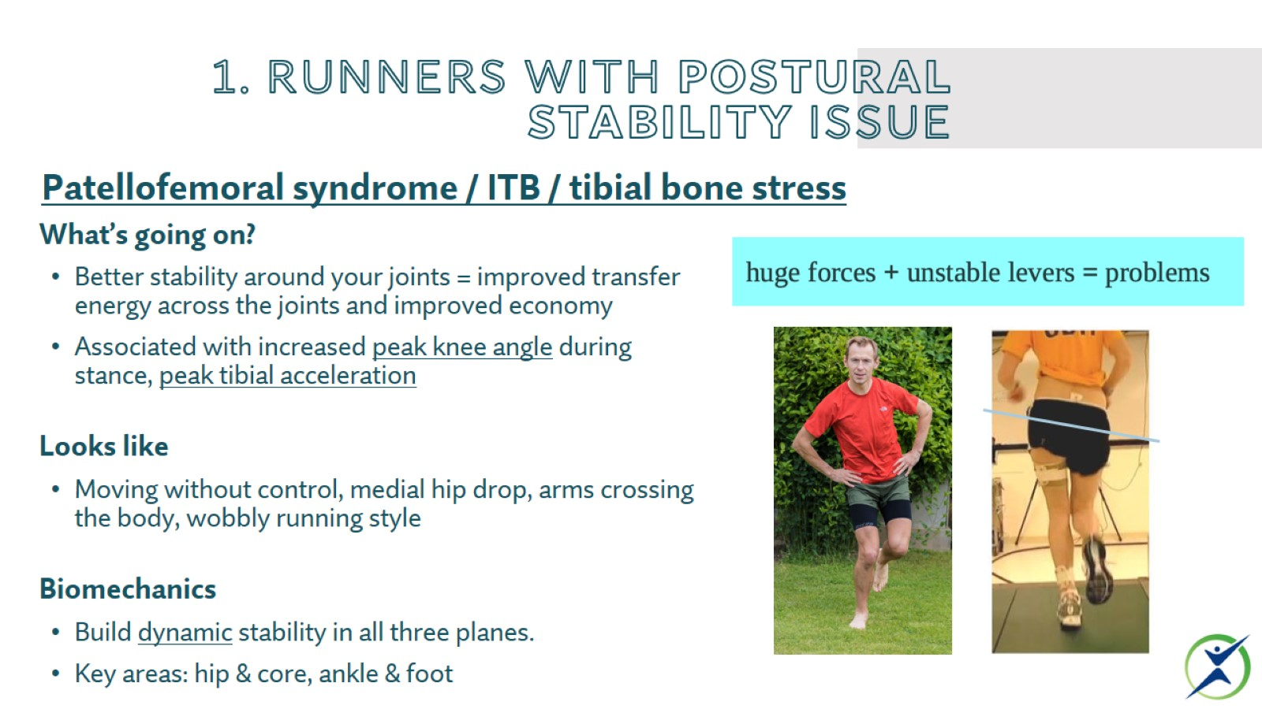
1. Runners with postural stability issue

Slide 21
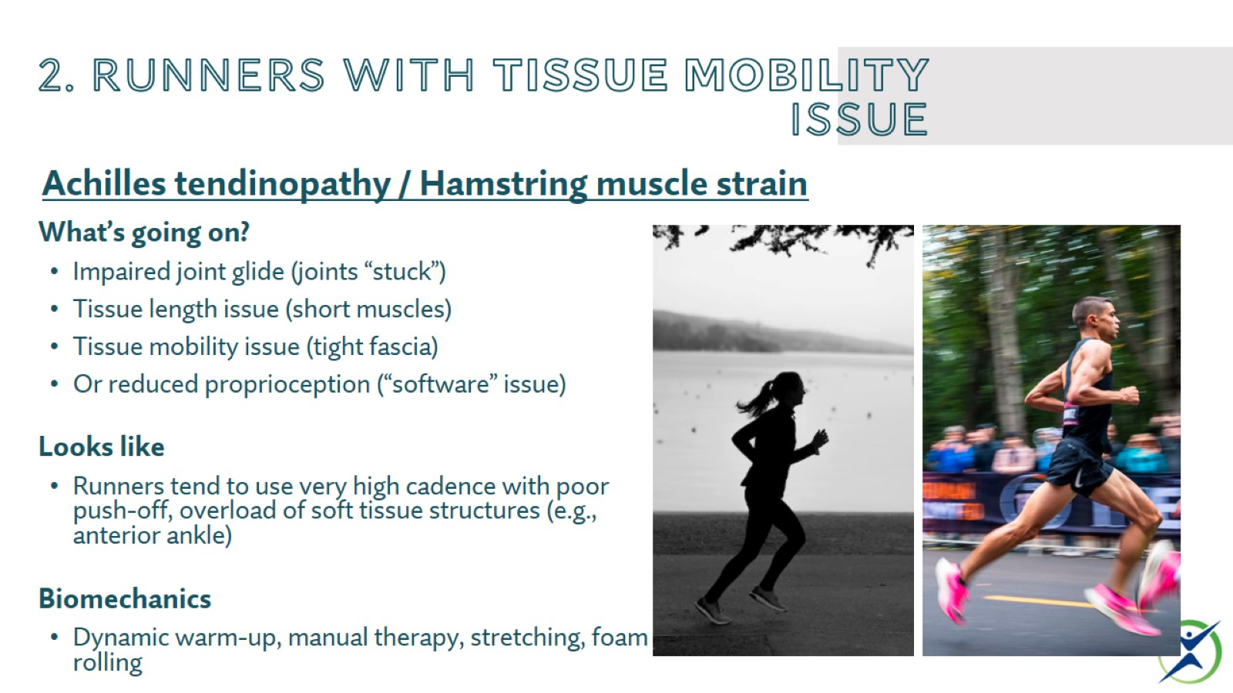
2. Runners with tissue mobility issue

Slide 22
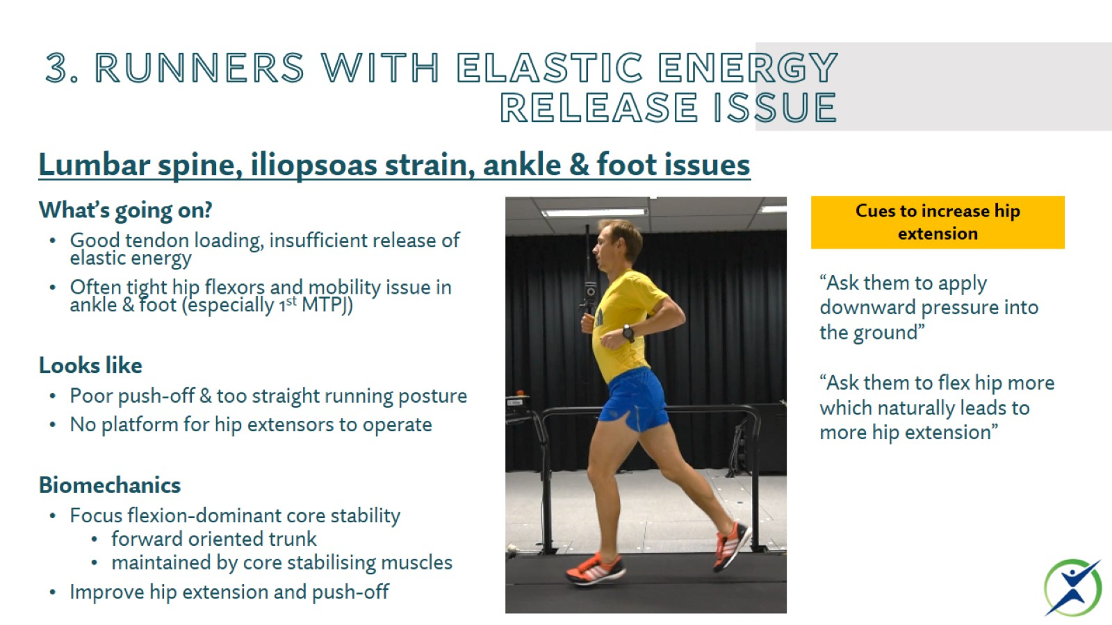
3. Runners with elastic energy release issue

Slide 23
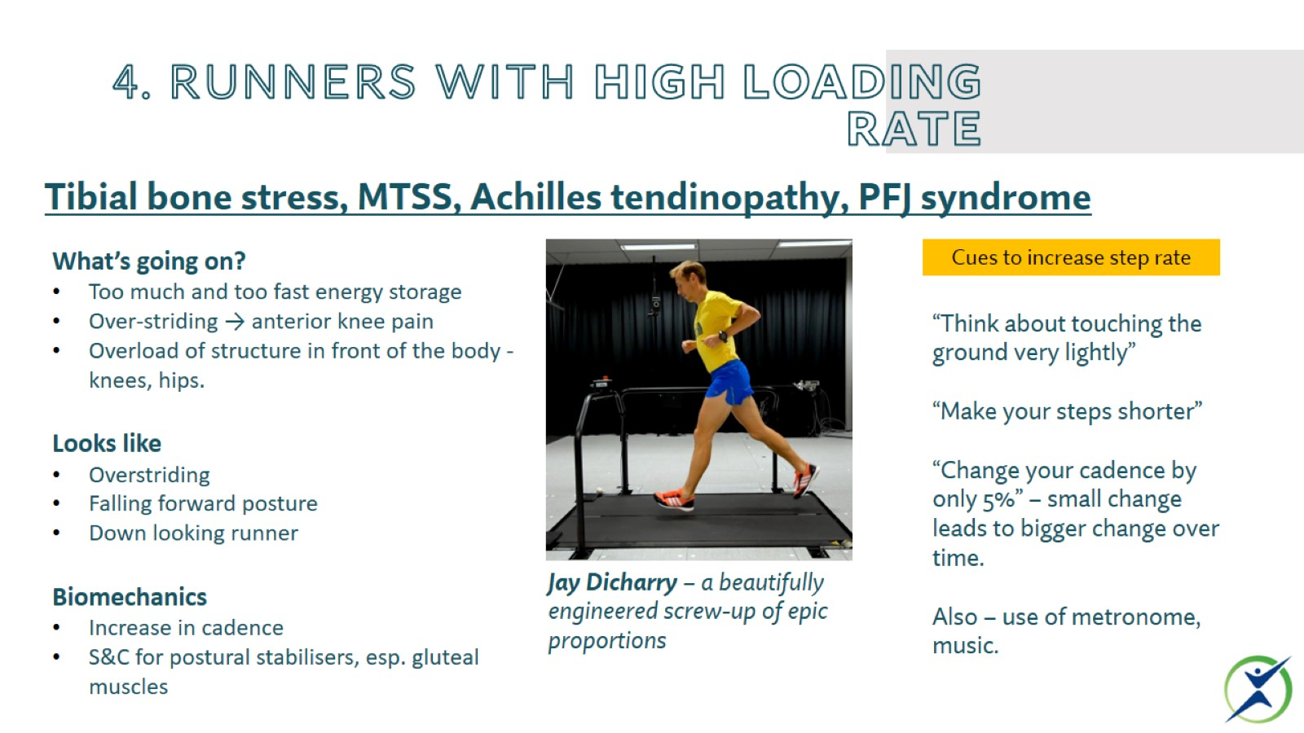
4. Runners with high loading rate

Slide 24
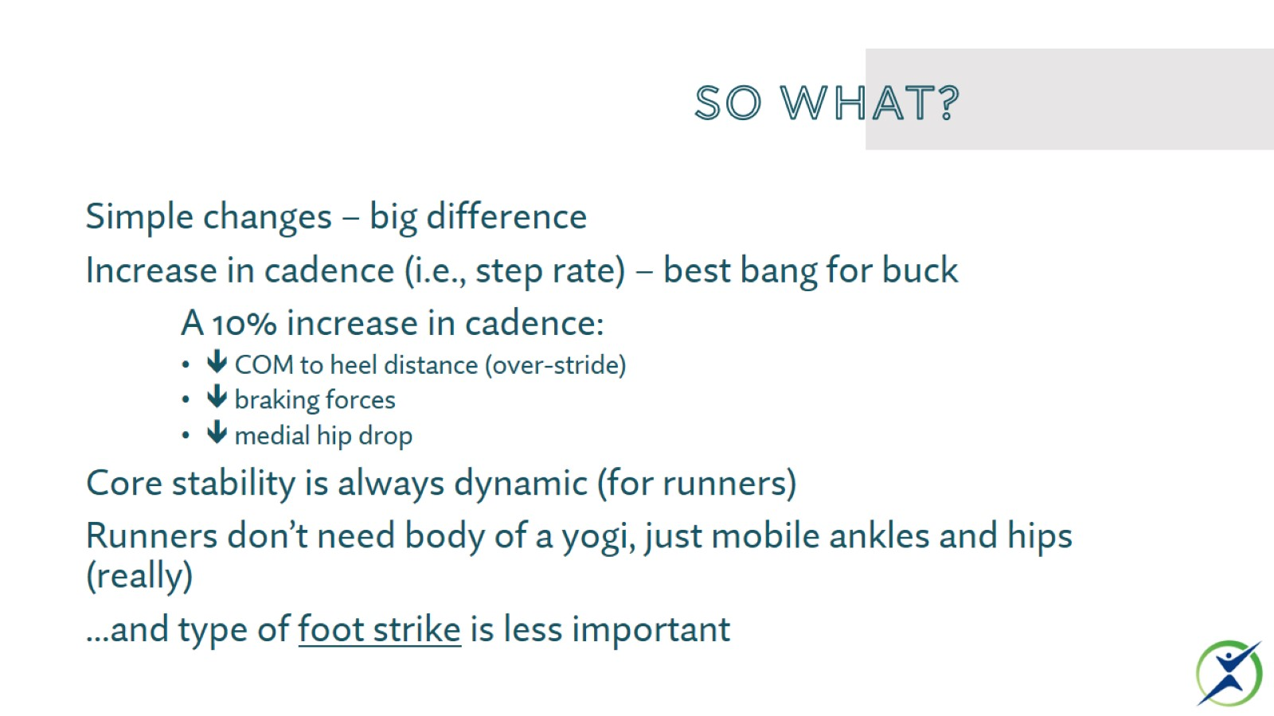
So what?

Slide 25

THANK YOU

Slide 26
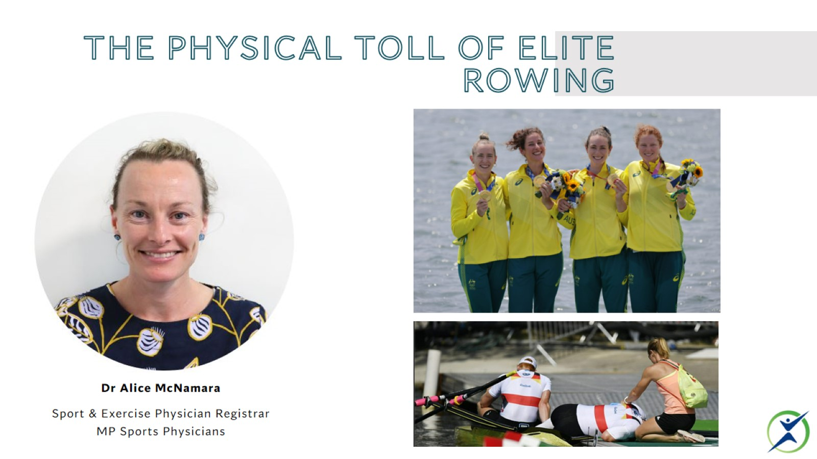
The Physical toll of elite rowing

Slide 27
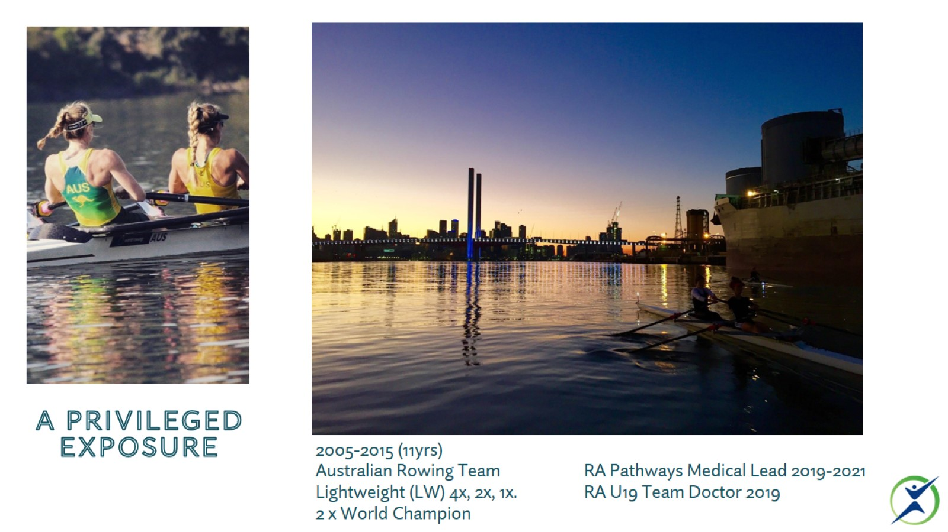
A privileged exposure

Slide 28
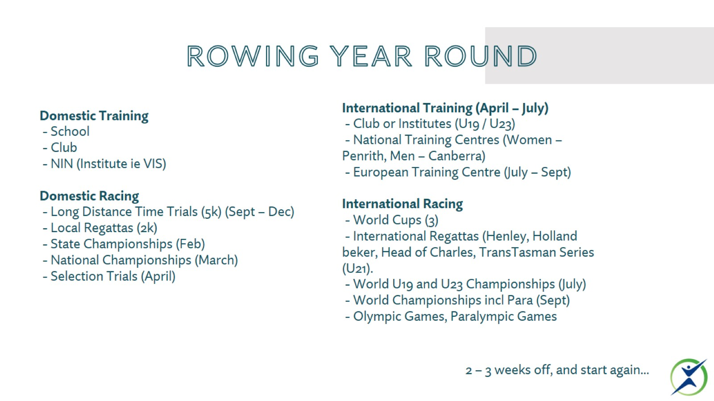
Rowing Year round

Slide 29
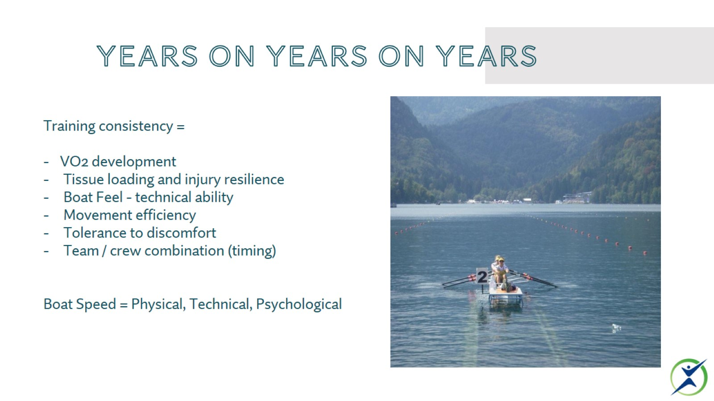
Years on years on years

Slide 30
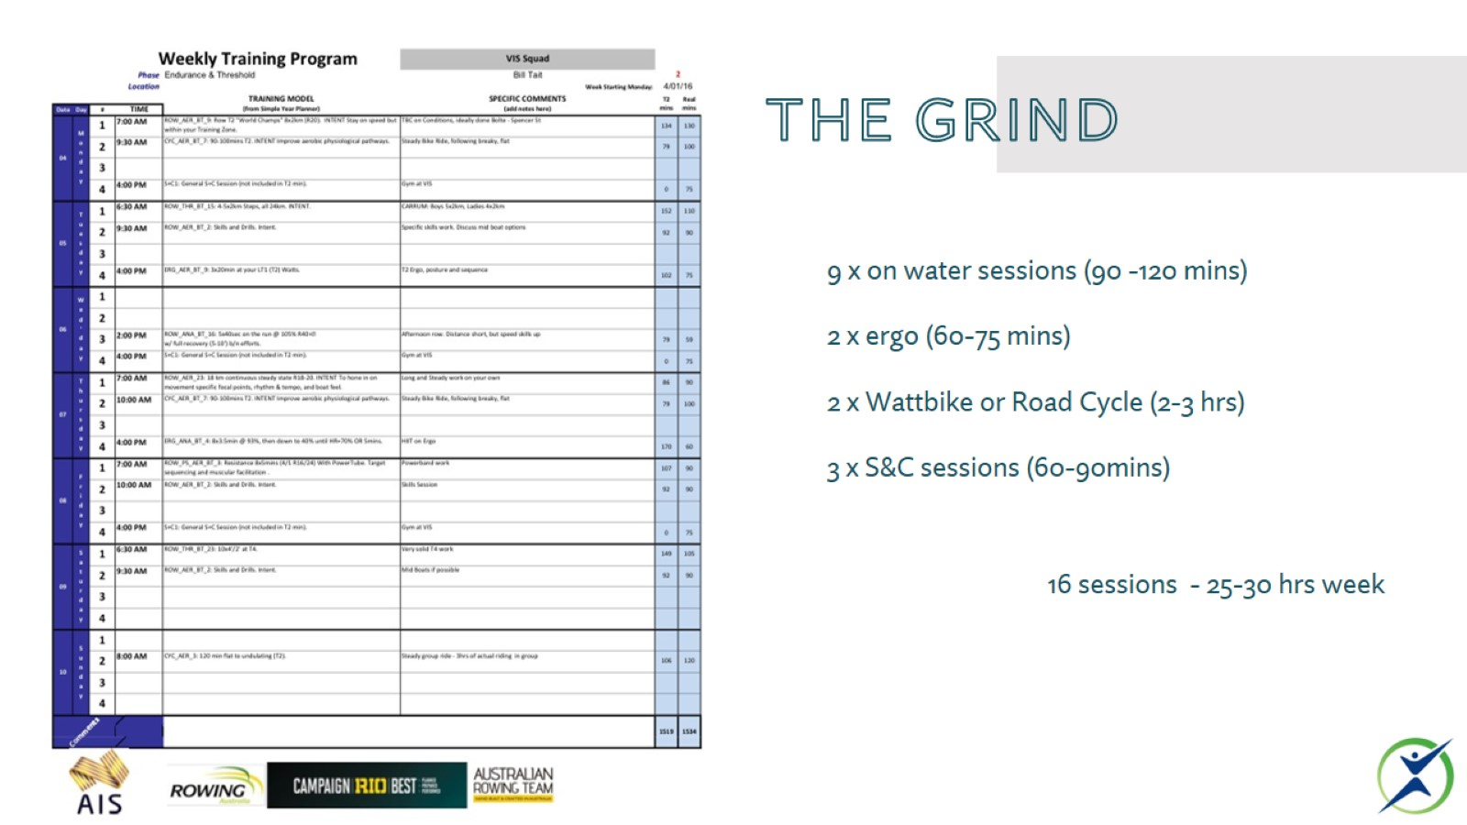
The grind

Slide 31
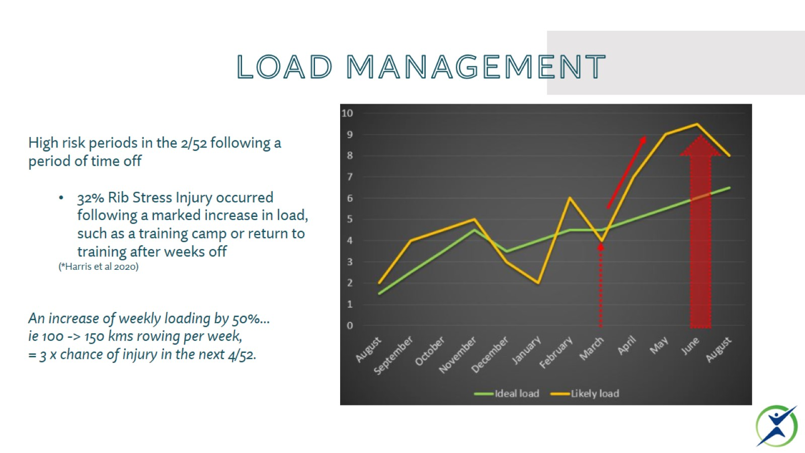
Load management

Slide 32
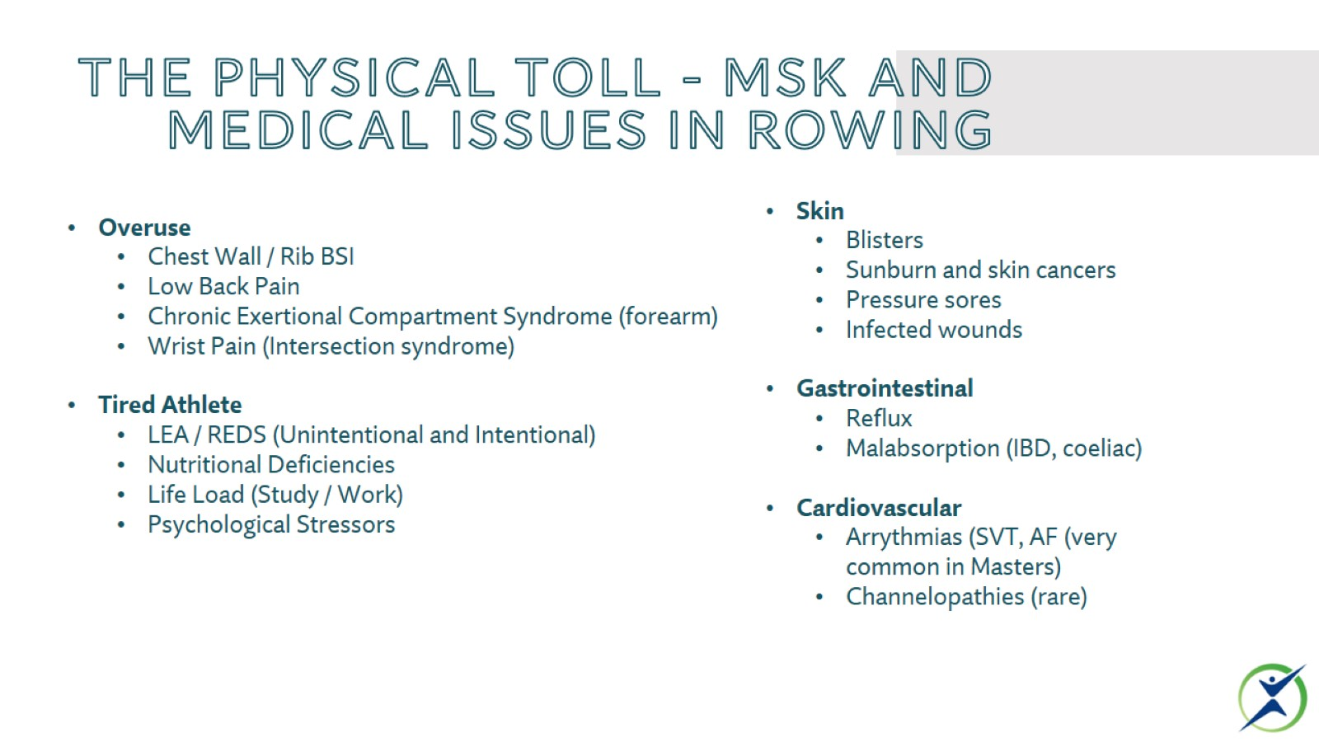
The Physical Toll - MSK and Medical issues in Rowing

Slide 33
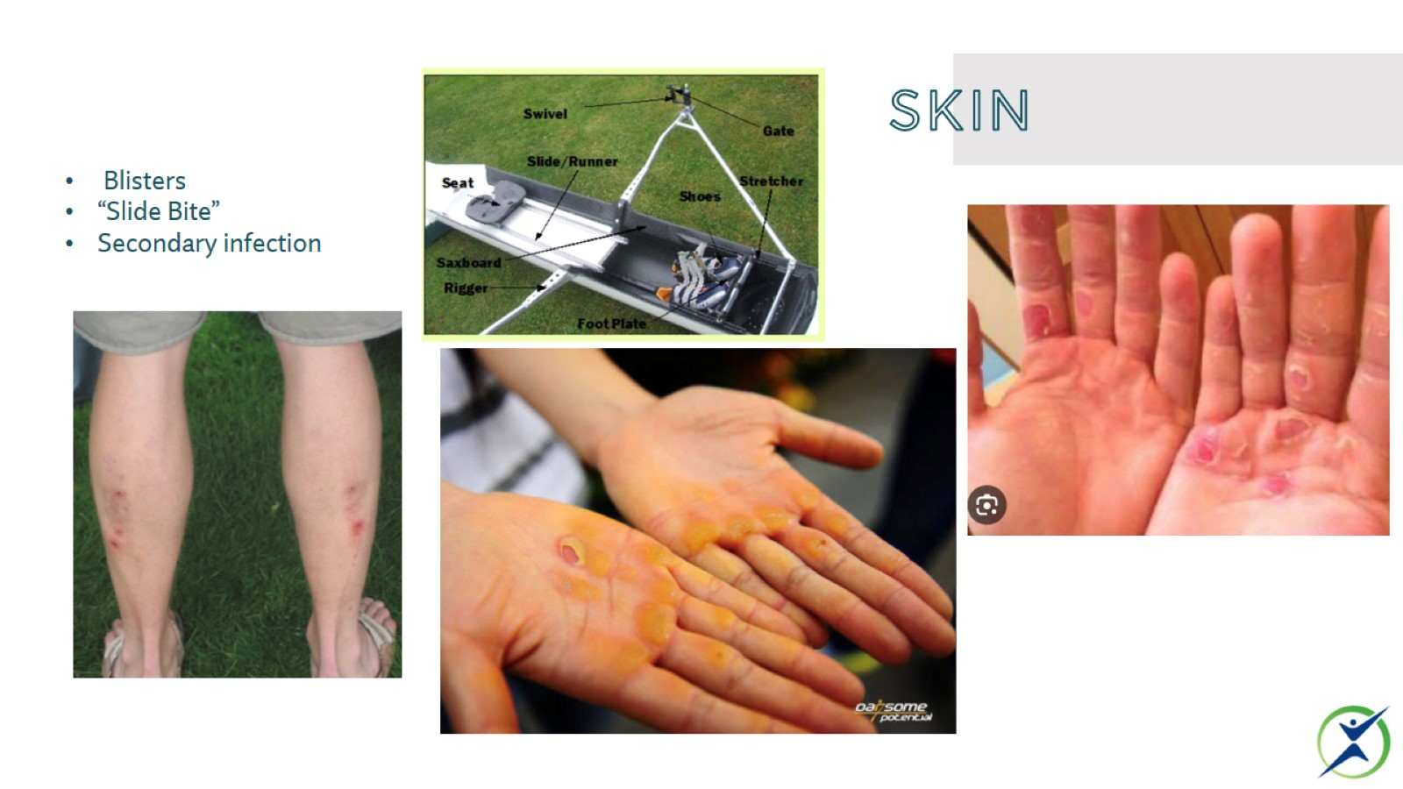
skin

Slide 34
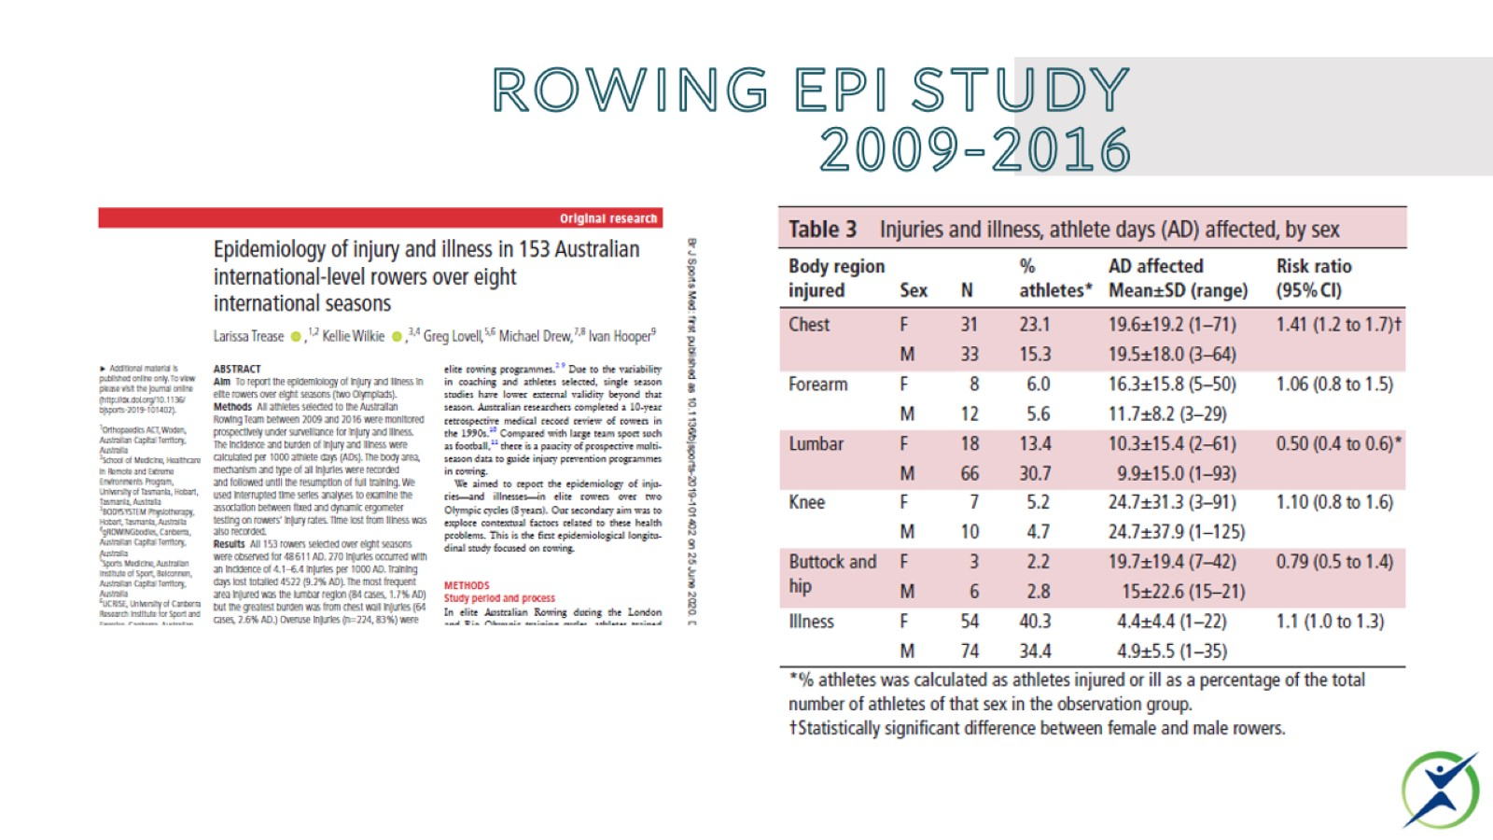
Rowing Epi study
2009-2016

Slide 35
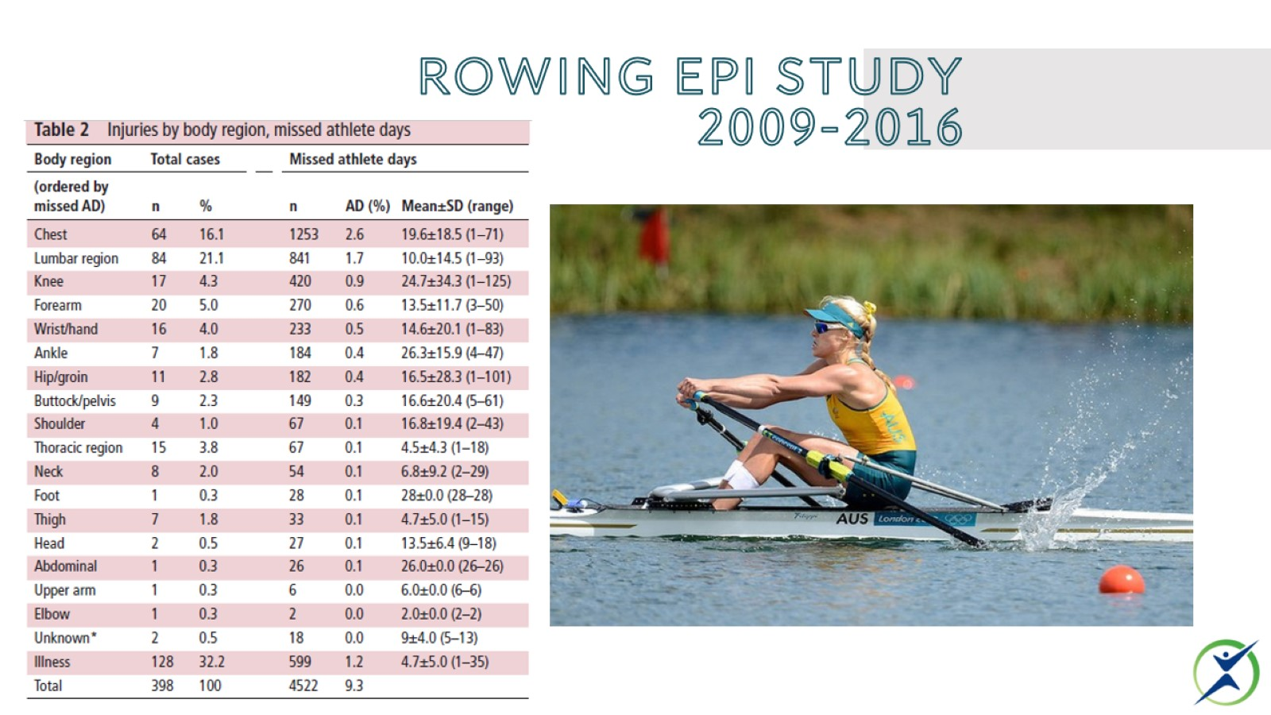
Rowing Epi study
2009-2016

Slide 36
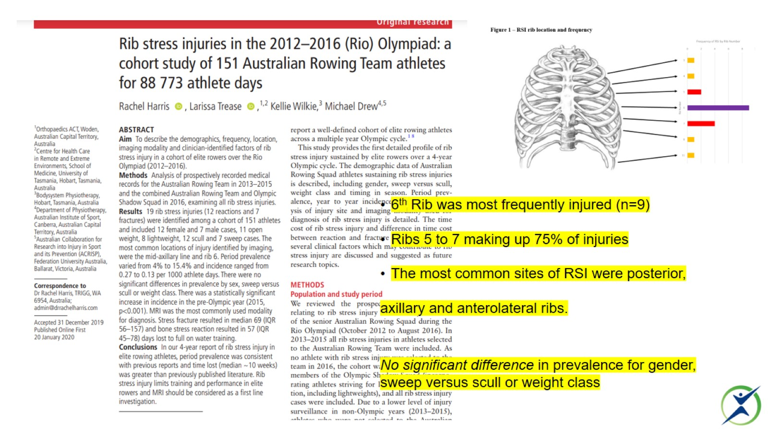
Ribs

Slide 37
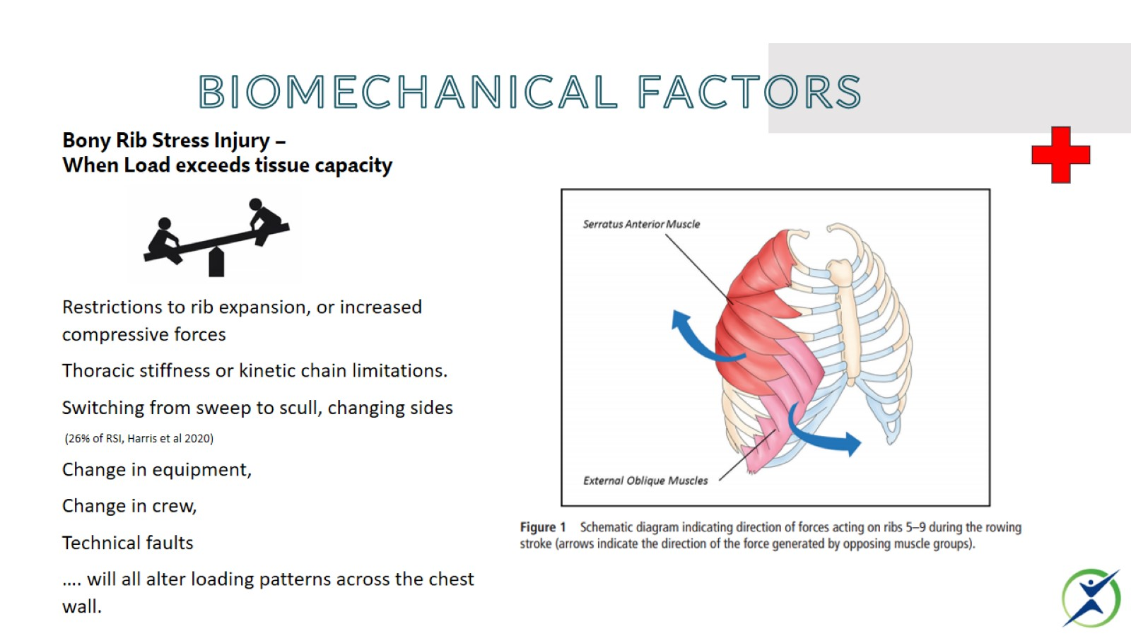
Biomechanical Factors

Slide 38
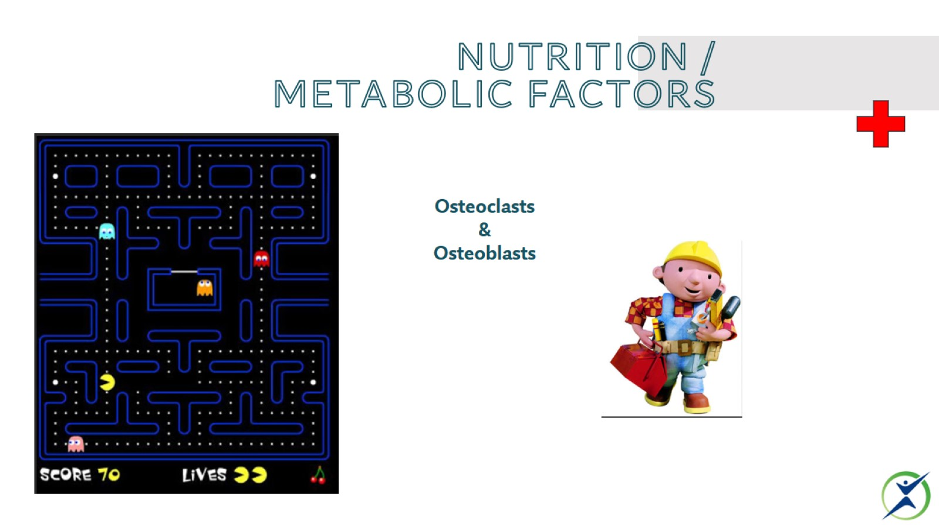
Nutrition / metabolic Factors

Slide 39
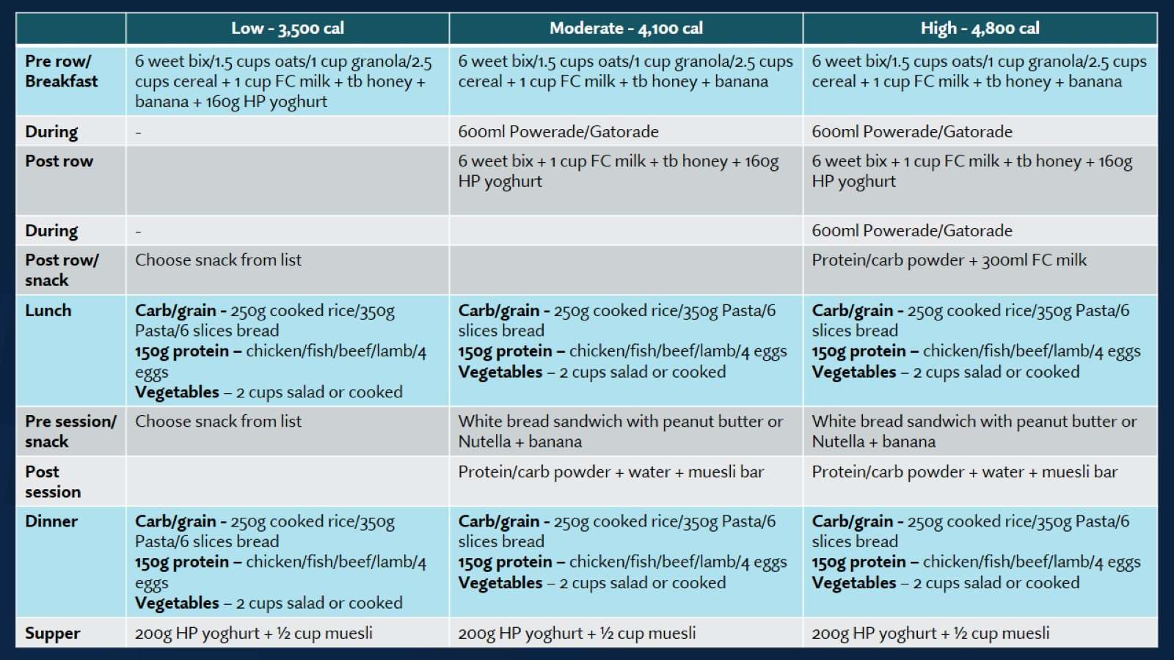

Slide 40
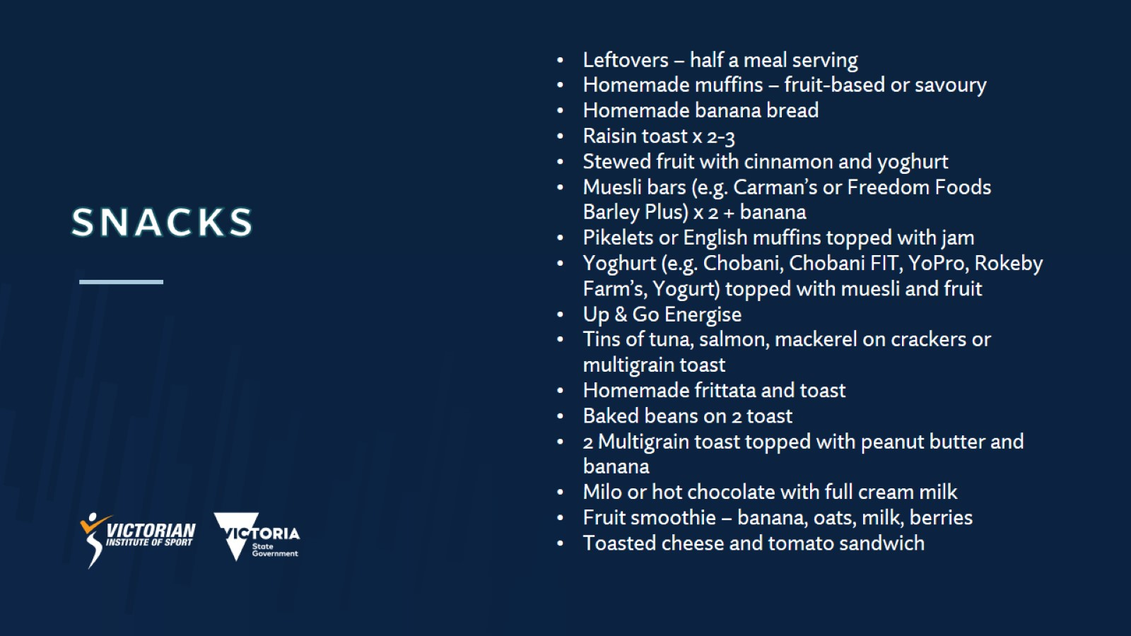
SNACKS

Slide 41
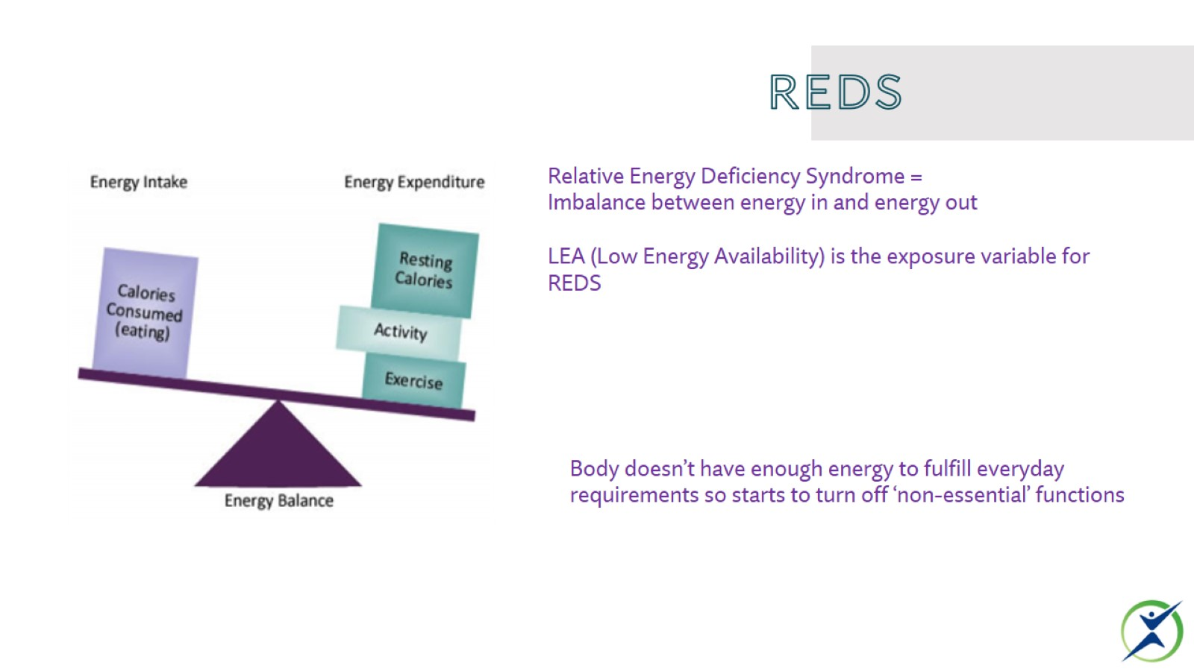
REDS

Slide 42
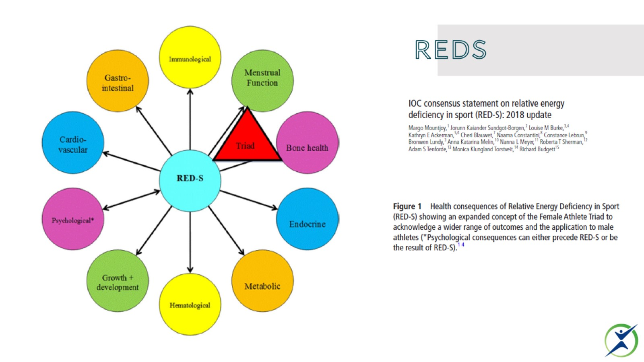
REDS

Slide 43
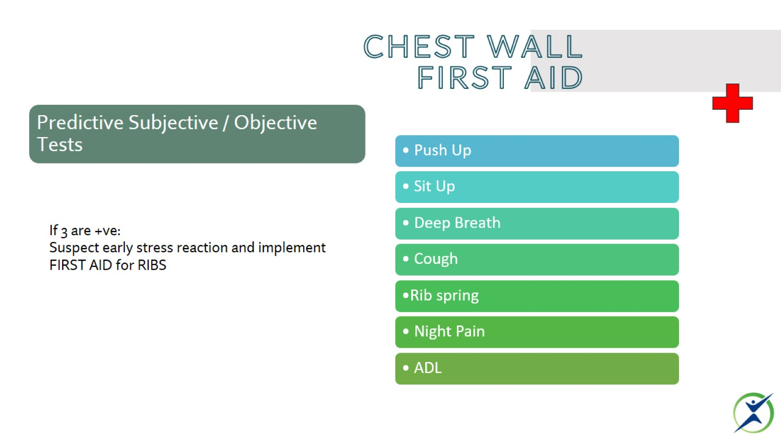
Chest wall first aid

Slide 44
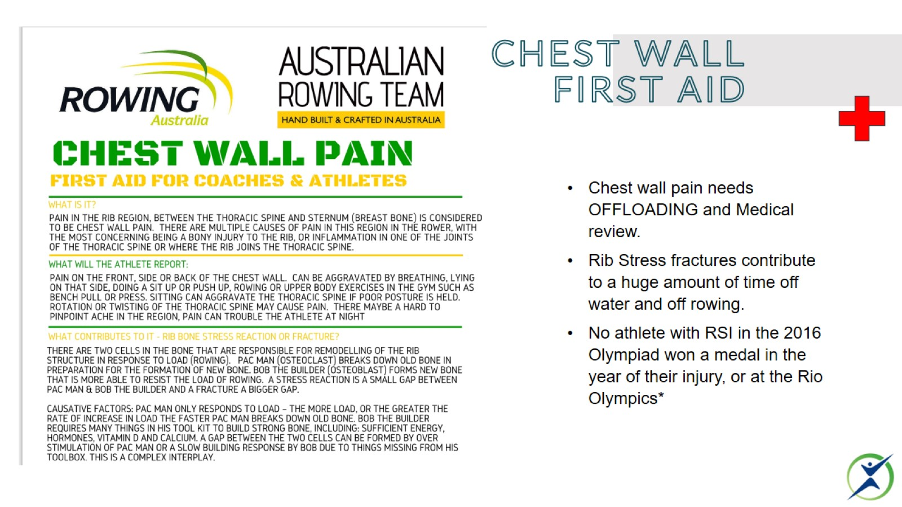
Chest wall first aid

Slide 45
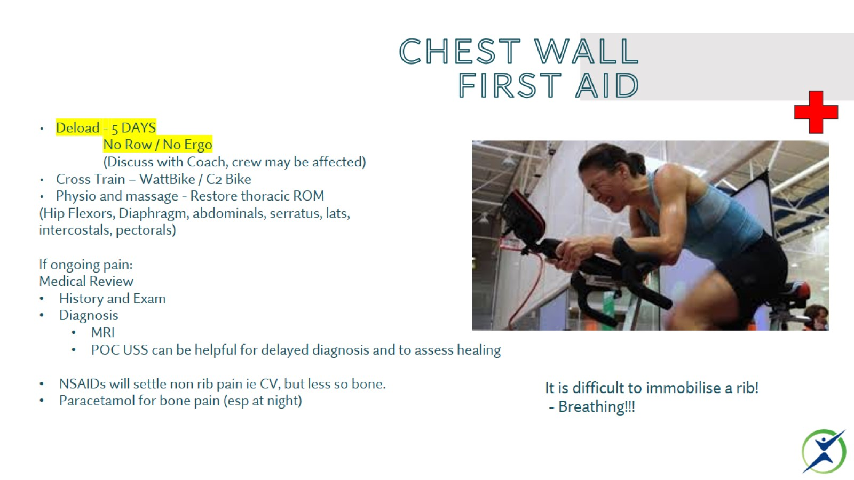
Chest wall first aid

Slide 46
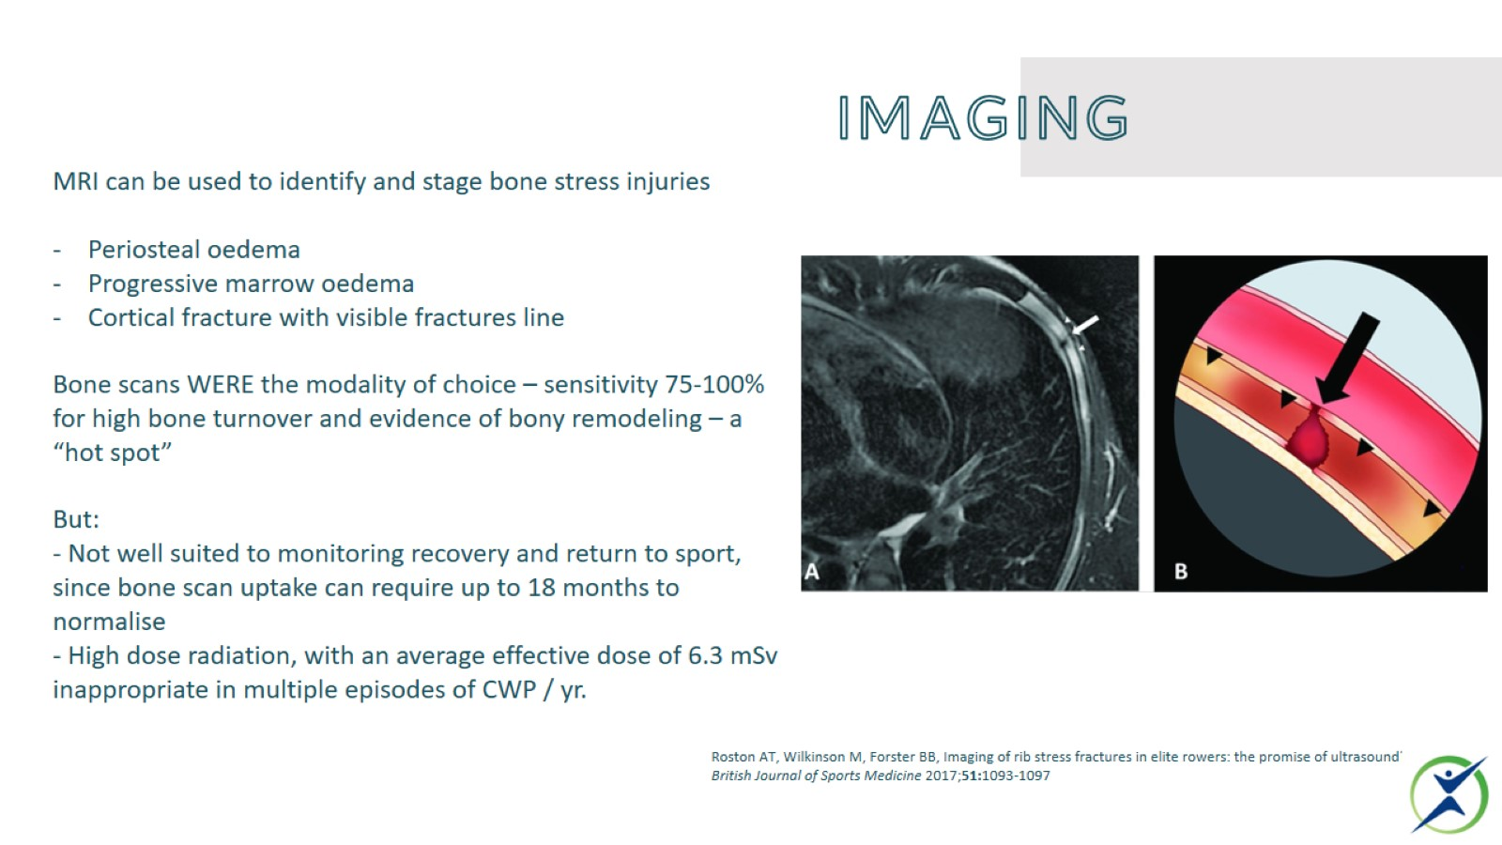
imaging

Slide 47
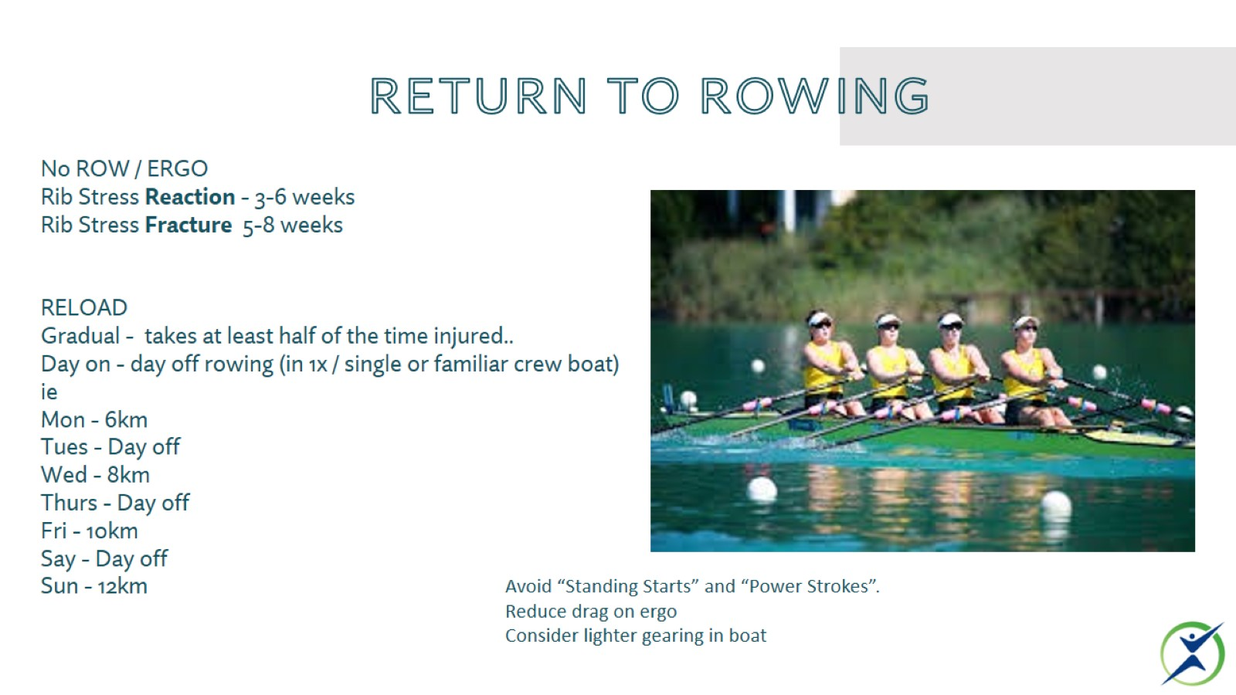
Return to rowing

Slide 48

Thank you

Slide 49
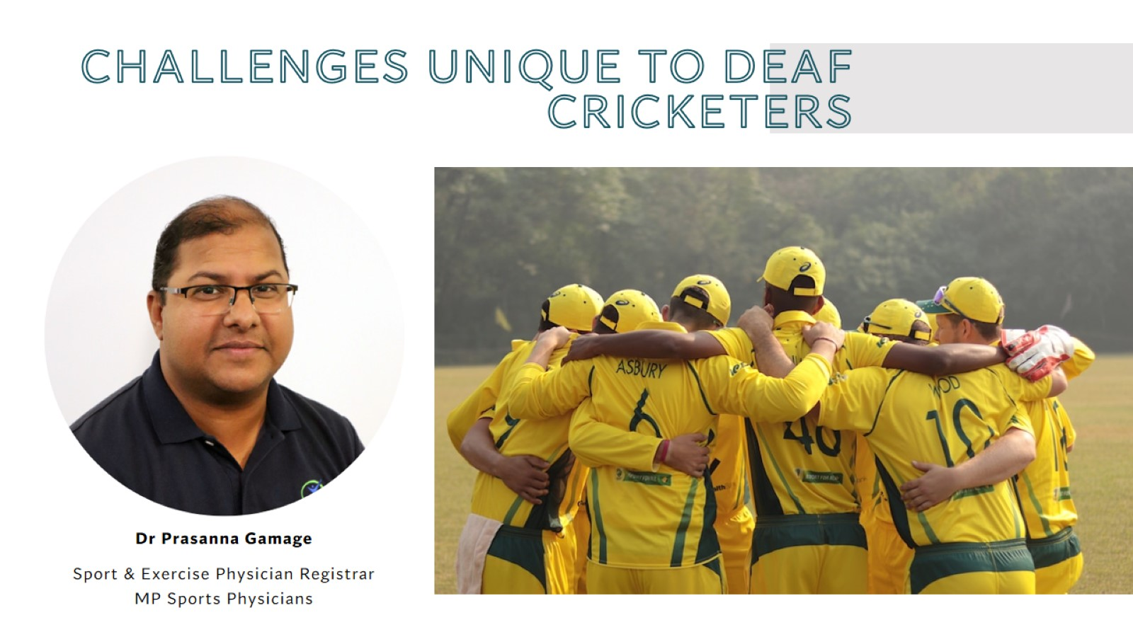
Challenges unique to deaf cricketers

Slide 50
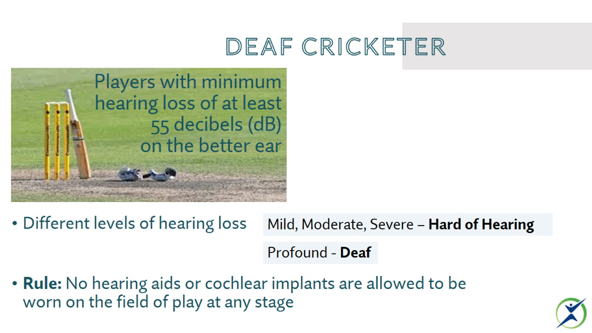
DEAF CRICKETER

Slide 51
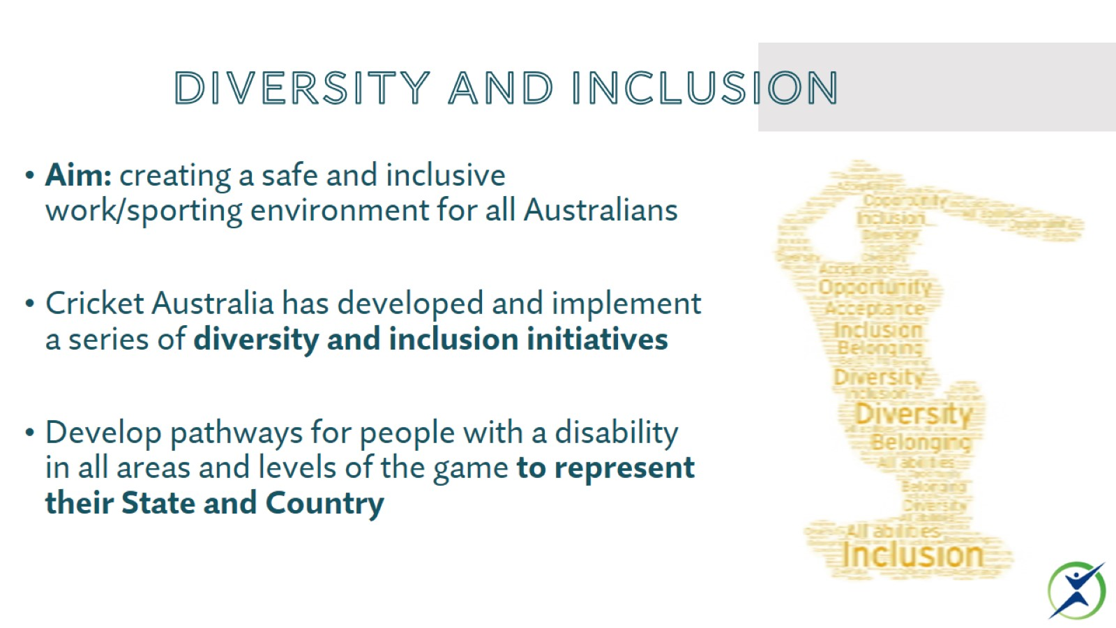
DIVERSITY AND INCLUSION

Slide 52
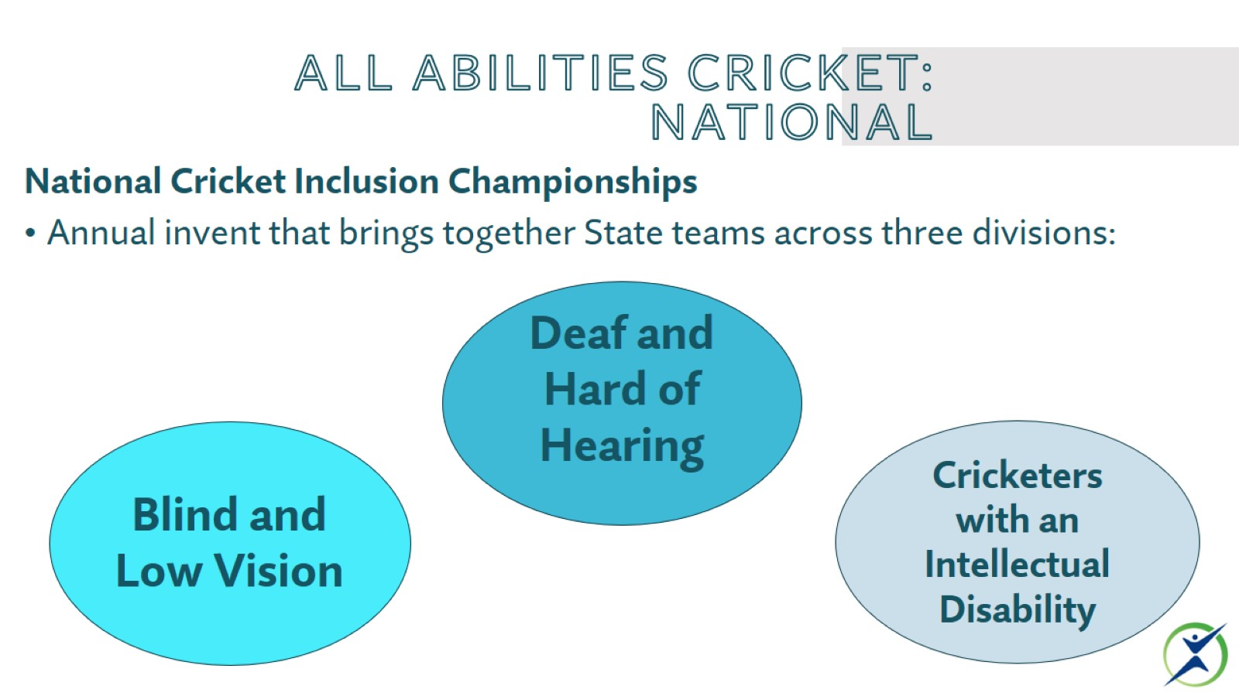
ALL ABILITIES CRICKET: national

Slide 53
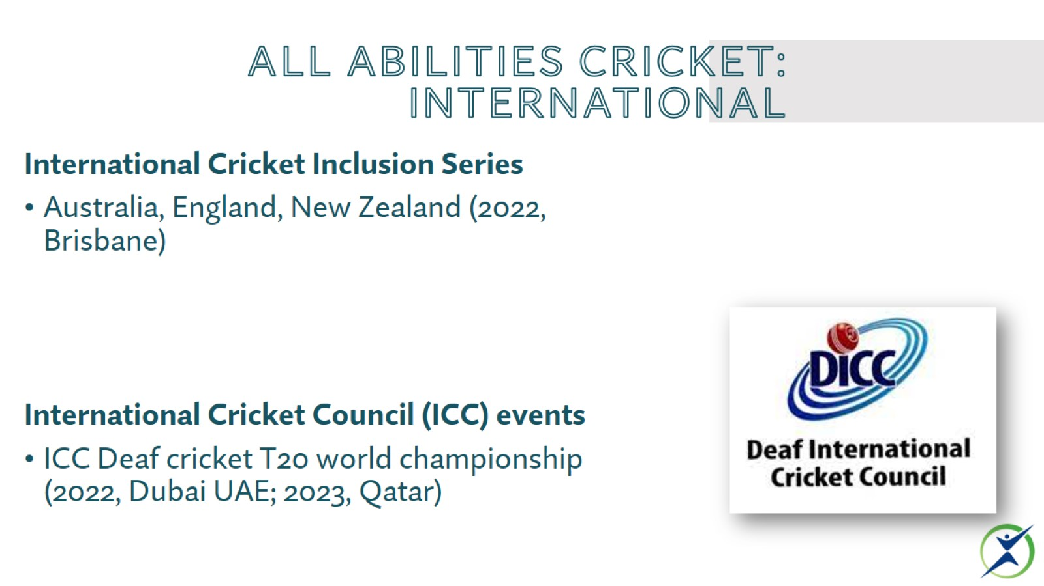
ALL ABILITIES CRICKET: international

Slide 54
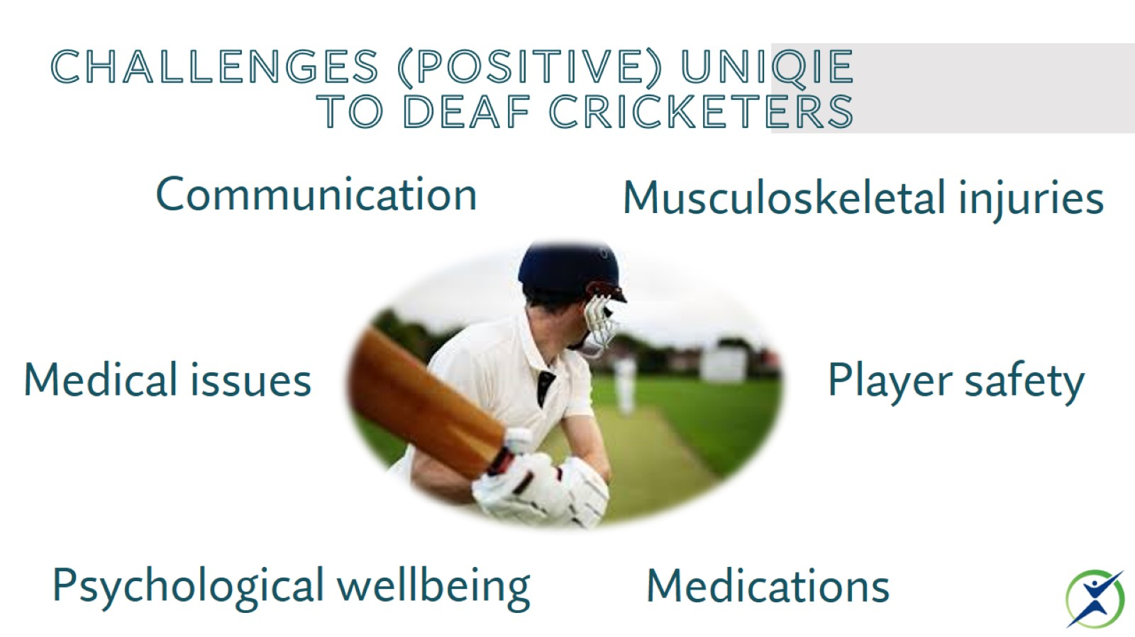
CHALLENGES (POSITIVE) UNIQIE TO DEAF CRICKETERS

Slide 55
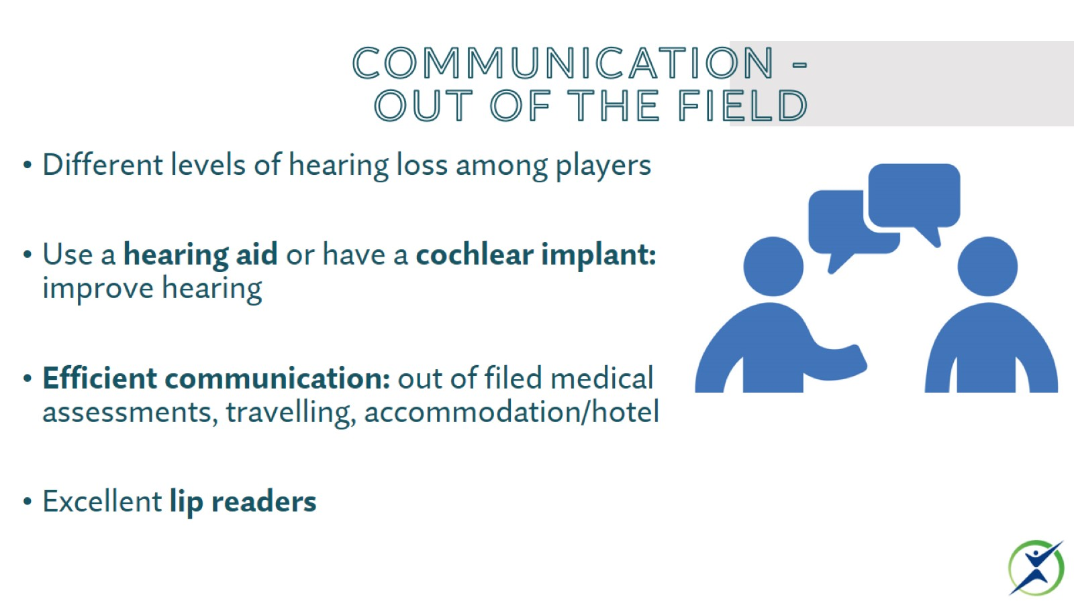
COMMUNICATION -
OUT OF THE FIELD

Slide 56
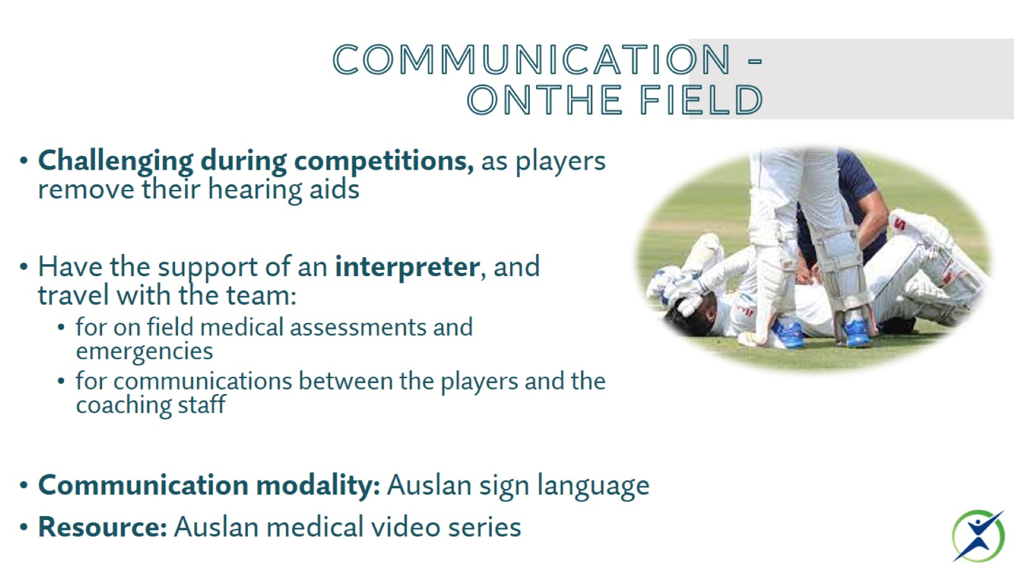
COMMUNICATION -
ONTHE FIELD

Slide 57

COMMUNICATION

Slide 58

Medical issues

Slide 59

Musculoskeletal issues

Slide 60

Psychological wellbeing

Slide 61

Player safety

Slide 62


Slide 63

cellular matrix and other knee injectables

Slide 64

What is knee arthritis?

Slide 65

What are the causes of symptoms?

Slide 66


Slide 67

What options do we have for treatment?

Slide 68

What if those things don’t work?

Slide 69


Slide 70

corticosteroids

Slide 71

PRP

Slide 72

hyaluronans

Slide 73

Combinations prp + ha (Cellular matrix)

Slide 74

Summary

Slide 75

Exceptional Performance Teams

Slide 76

2032+ Final (vimeo.com)

Slide 77


Slide 78


Slide 79

ONLINE ACCESS

Slide 80

Event 2

Slide 81

Thank you

